Slide 1

Restoring American Seapower
Bryan Clark, Peter Haynes, Bryan McGrath, Craig Hooper, Jesse Sloman, and Tim Walton

Slide 2
Objectives of a new architecture
More effective at great power competition
  Deterring escalation by being able to deny, delay, and punish aggression
  Countering sub-conventional or “gray zone” aggression in contested areas
Improved capacity for training and preparation
  Faster incorporation of lessons and learning from real-world ops and tests
  Better process for maintaining proficiency for high-end conflict
Better integrated with allies and partners
  And accounting for likely seams in capability or employment
More options for platforms, payloads, and sensors
  Enabling greater flexibility in “kill chains” or webs
Exploit manned-unmanned teaming
  Particularly in ISR/counter-ISR competition
Achievable fiscally and with industrial base
  Including maintenance industrial base

Slide 3
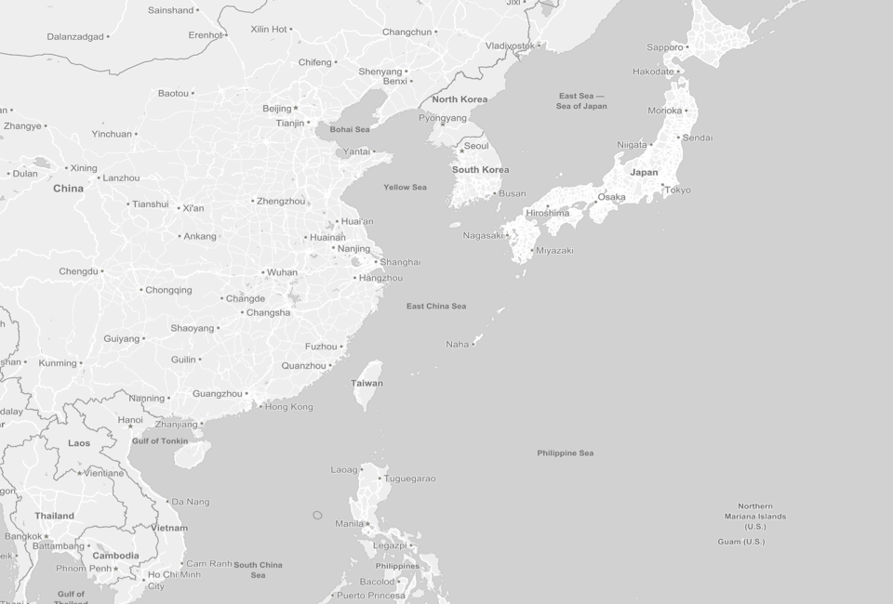
Return of great power competition
NOTE: Range arcs are illustrative of possible threats rather than an actual force laydown.
Northern Military District
SS-N-27A (500 km)
JH-7 Combat Radius
(1650 km)
Central Military District
DF-21D/ CSS-5 Mod 3
(1500 km)
Western Military District
OTH-R Receivers
H-6K (1800 km)
CJ-10 (2,200 km)
Eastern Military District
OTH-R Receiver
DF-11A/ CSS-7 Mod 1
(350 km)
DH-10/ CJ-10
(2200 km)
Southern Military District
OTH-R Receivers
DDG (3 days, 1200 km)
Chinese IRBMs/ICBMs
DF-26 | 4,000+ km
DF-4 (CSS-3) | 5,300+ km
DF-5A (CSS-4 Mod 2) | 12,000+ km
DF-31 (CSS-9 Mod 1) | 7,500+ km
DF-31A (CSS-9 Mod 2) | 11,000+ km
S-300PMU (90 km)
SS-N-22 (240 km)
S-300PMU1 (150 km)
Oahu
7000 km
S-300PMU2/ HQ-9 (200 km)
S-400 (400 km)
CONUS
7500+ km
Su-30MKK Combat Radius
( 1349km)
SSK (18 days, 1730 km)
SS-N-27A (350km)
HN-3
(3000 km)
500 km
SSN (75 days, 3250 km)
Improving capabilities and revisionist objectives of China and Russia will require changes to strategy, mission priorities, and fleet architecture
YJ-82 (33km)
2

Slide 4
Study Methodology
Naval missions | Strategic approach | Operational concepts | Demands for Deterrence and Maneuver forces in: | Fleet Architecture
Deter conflict | Denial and delay or punishment | Air and Missile Defense EMS warfare Anti-submarine warfare Undersea Warfare Anti-surface and Strike warfare Mine warfare Mine counter-measures Amphibious operations | North & South America Northern Europe Mediterranean Africa Persian Gulf Gulfs of Aden / Oman Indian Ocean South China Sea East China Sea Pacific Arctic
Win the War at Sea
Respond to humanitarian crisis | Cooperative efforts with allies and partners
Maintain security
Platforms
Packages
Payloads
Basing
Readiness model
Number and type of platforms, payloads
Assess architecture

Slide 5

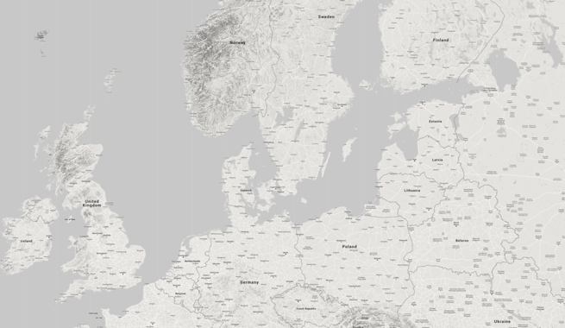
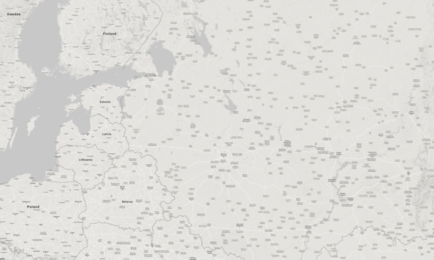

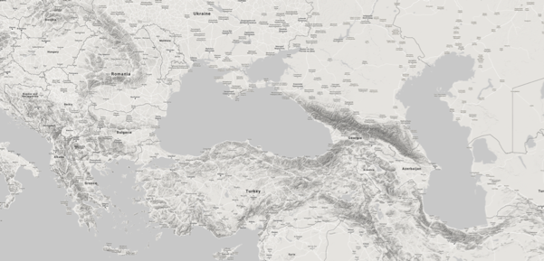
New strategic approaches needed
Iskander-M SRBM
(500 km)
250 km
250 km
Western Military District
Su-35 Combat Radius
(1500-1600 km)
OTH-R Transmitter
Missile
Brigade Base
Central Military District
OTH-R Receiver
S-300PMU (90 km)
S-300PMU1 (150 km)
S-300PMU2 (200 km)
250 km
S-300VM (250 km)
250 km
S-300V4/S-400/S-500 (400 km)
Southern Military District
29B6 Kontainer Over-the-Horizon Airspace Monitoring Radar
(3,000 km)
NOTE: Range arcs are illustrative of possible threats rather than an actual force laydown.
Aegis Ashore
BMD Location
In the future, U.S. forces will not be able to use same mobilization and response after aggression that it did in Iraq or Kosovo
250 km
5

Slide 6
New operational concepts

Slide 7

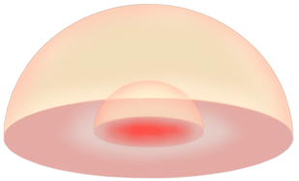


Increase AMD capacity w/new concept
ASBMs
ASCM Salvo
10-30 nm defense anti-air warfare
HVPs
5-10 nm ship self-defense systems
Lasers
RAM
ESSM
EW, HPM
CIWS
Medium range AMD approach increases defensive capacity by using smaller interceptors and new technologies including lasers, HPMs, and EW

Slide 8
AMD capacity could dissuade attacks
Weapon | Notional current VLS allocation | Proposed VLS allocation
SM-3 | 10% | 10%
SM-6 | 20% | 20%
SM-2 | 30% | 15%
ESSM | 10% | 25%
Tomahawk | 25% | 25%
VLA | 5% | 5%
1 Mk-45 gun with HVP | 0 | 20 rounds per minute
1 400kW laser | 0 | 6 seconds per missile defeat
Weapon | Notional probability of kill
SM-6 | 0.7
SM-2 | 0.7
ESSM | 0.7
Mk-45 gun with HVP | 0.4
Laser | 0.4
EW | 0.4
HPRF | 0.4
New AMD approach also provides more repeatable capacity for multiple salvos – EW, HPRF, laser, and Mk-54

Slide 9
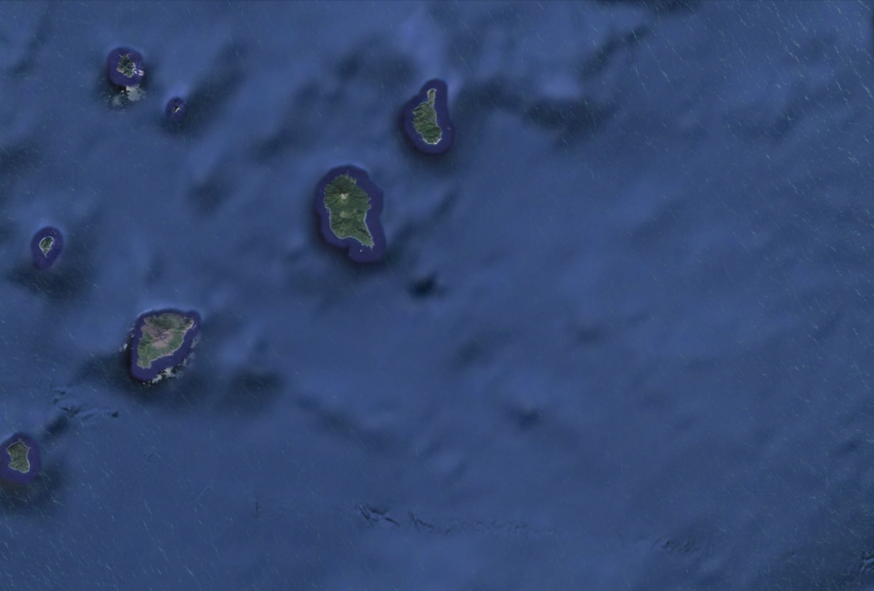


Hide with EMCON & stand-in jamming
Ship and UUV-deployed systems emit low-power cover pulse to mask strike group
Ship uses agile, wideband jammer to disrupt and offboard, expendable decoys to attract ASCMs
UUV-launched UAVs jam enemy communications
Strike group moves through contested space at EMCON
Decoy commander observes UAS activity via passive methods to minimize detection risk
Autonomous USV and UUV decoys
New approaches for operating inside contested areas will rely on EMCON, decoys, and LPI-LPD defensive jamming–need to address EO/IR

Slide 10
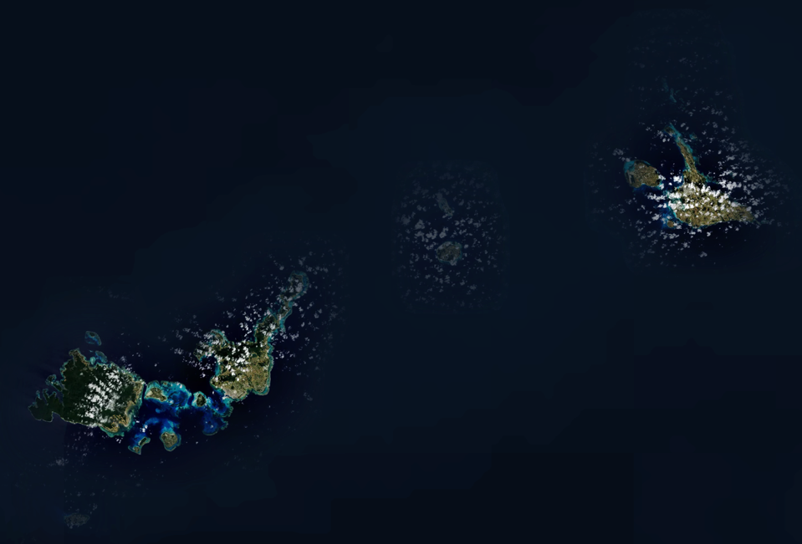

Enemy EW drives new C4ISR concepts
Multi-static detection
UAV illuminators
LIDAR or multi-static laser detection
Background EM energy enables passive coherent location
Passive targeting UAVs
Naval forces will need to shift to passive and LPI/LPD sensors and LPI/LPD line-of-sight comm networks–long-haul networks will be challenged

Slide 11


Offensive ASW by unmanned systems
“Pouncer” aircraft
XLUSV w/ Variable Depth Sonar
Unmanned Gateway Buoy
Glider USV w/ towed array receiver
Moored Gateway Buoy
Submarine Contact
ASW missile
Sub-Surface Repeater
Deep Sound Channel Communications
Weapons range too short to have UxV in position to engage
Transformational Reliable Acoustic Path System (TRAPS)
Passive TRAPS & Active LF sonar provide targets for manned and unmanned pouncer aircraft to engage

Slide 12
Defensive ASW focused on suppression
“Pouncer” aircraft
XLUSV w/ Variable Depth Sonar
Unmanned Gateway Buoy
Submarine Contact
ASW missile
Transformational Reliable Acoustic Path System (TRAPS)
LF active sonar and unmanned sensors find subs; standoff or air-launched weapons suppress and drive them off

Slide 13



Distributed strike and SUW
MALE UAVs
USVs w/ SIGINT
CVL
XLUUV w/UAV for targeting, EW
SSNs w/ ASCM
Passive targeting from Tern UAVs, UAVs from XLUUVs, and XLUSVs;
Surface combatants and CVL conduct high-volume, short-duration attacks

Slide 14
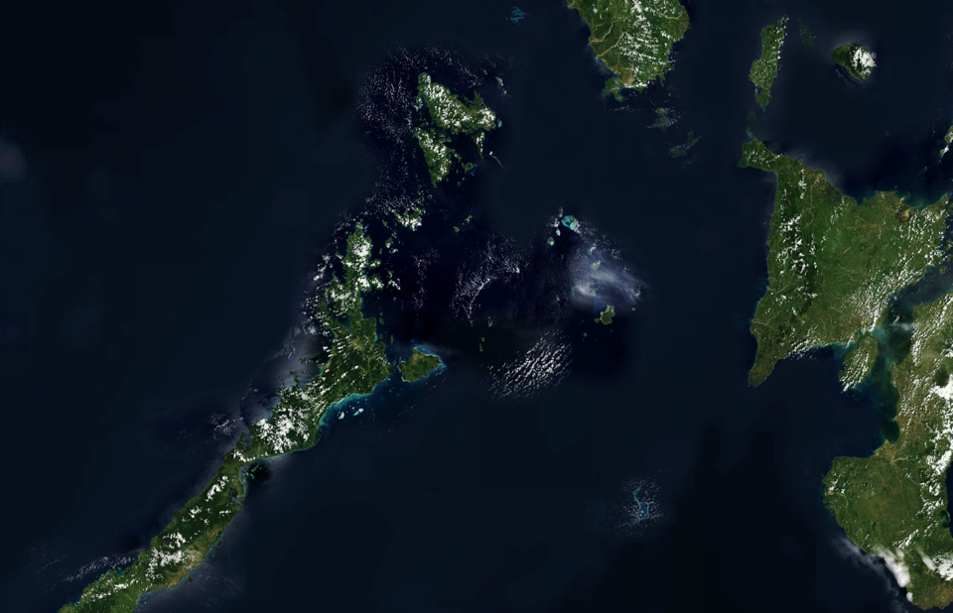

Amphibious ops add cross-domain fires
Small UAVs for OTH targeting
Ship magazines deepen fires capacity
Direction of aggressor forces
MV-22s and UAV resupply
Runway
Refueling area
Maintenance area
Amphibs serve as mobile logistics hubs
Sustain FARPs
LCACs bring in HIMARS and IFPC
EPF deliver aviation fuel and support equipment
Small UAVs for OTH targeting
MV-22s deliver troops to establish lodgment
Expeditionary bases can support air operations, anti-air & anti-ship weapons, or logistics inside contested areas

Slide 15

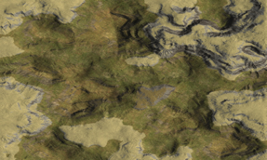



Mine warfare with unmanned systems
UAV with mine detection system
Unmanned vehicle support ship
XLUSV/CUSVs clear mines
Red micro-UUV smart mines
XLUUVs w/ micro-UUV smart mines
Mines and UUVs merging; will be deployed or found and cleared by larger UUVs and USVs; keeps manned ships out of minefield

Slide 16





New logistic concept for distributed ops
Direction of aggressor forces
Unmanned Vehicle Support Ships maintain XLUUVs and XLUSVs
T-AOEs refuel and reload ammunition and dry stores of ships at sea
T-AKEs deliver dry cargo and ammunition to Maneuver Force ships
T-AKs reload ammunition and dry stores of T-AOE and T-AKE
CONSOL T-AOTs refuel T-AOEs underway
T-AOEs refuel Maneuver Force ships
CONSOL T-AOTs & T-AKs could reduce number and risk to T-AOEs (and possibly
T-AKEs) through expeditionary refuel/reload at relatively secure locations

Slide 17

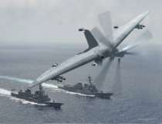
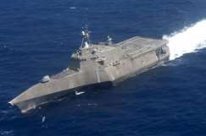
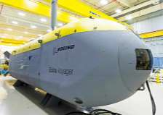
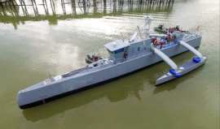
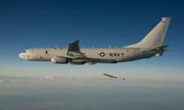
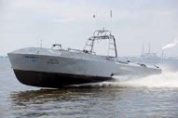
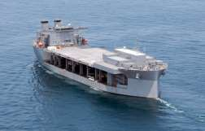
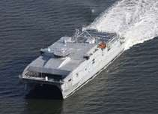
Force packages for new opn’l concepts
Counter-C4ISR Group
  FF / FFG w/ 2 TERN UAV
  2 CUSV decoys
  2 XLDUSV w/ ICADS package
Anti-Submarine Warfare Group
TERN UAV
FF (today)
FFG w/ VDS, LR ASROC, TERN UAV
P-8A
SSN
XLDUSV and XLDUUV w/TA
Mine Countermeasures Group
XLDUUV
XLDUSV
Unmanned vehicle support ship
3-4 CUSVs
2 XLDUSVs
• 2 MH-60S
P-8A
CUSV
Unmanned Vehicle Detachment
Unmanned vehicle support ship
3-4 CUSV
4 TERN UAVs
3-6 XLDUSVs & 3-6 XLDUUVs
ESB (UxV Support Vessel)
EPF (UxV Support Vessel)

Slide 18
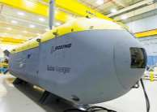
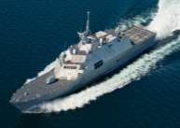
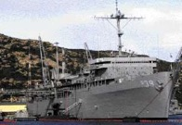
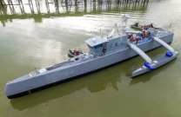
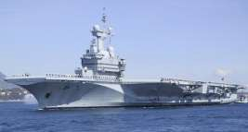
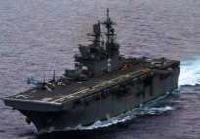
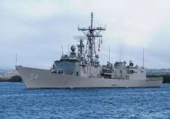
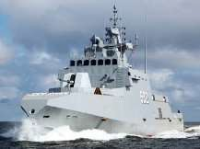
Force packages for new opn’l concepts
Mining Group
  FFG
  2-3 XLDUUVs
  Micro-UUV smart mines
XLDUUV
FF (today)
4-ship Amphibious Ready Group
  CVL
  3 LPDs or L(X)Rs
Tender
XLDUSV
CVL (today)
Surface Warfare group
1 DDG
2 FFG with TERN UAVs
XLDUSV w/SIGINT, TA for targeting
CVL (future)
Patrol vessel
Littoral combat group
FFG
3 Patrol vessels
Tender
FFG (future)

Slide 19
Naval posture
Force packages, presence ,and basing

Slide 20

Deployed fleet needs to be redesigned
Today’s “presence” force is not designed to deter
  It’s a small version of “war winning” force that responds after the fact
  Not designed to deter or counter particular adversaries
  Able to do many different ops, but not the most important ones
  Optimized for efficiency, not effectiveness
“Deterrence Forces” should be designed to deny & punish
  Lethal – to interdict aggression and impose costs
  Survivable – to provide staying power until offensive capacity is depleted
  Tailored – to geography, alliances, adversaries in each region
“Maneuver Force” reinforces and sustains combat operations
  Falls in on Deterrence Force to counter-concentrate at point of conflict
  Provides high-capacity offensive capabilities
  Conducts training, experimentation, exercises, demonstrations
Deployed fleet should consist of “Deterrence Forces” in each region and a “Maneuver Force” not tied to a particular region

Slide 21












Deterrence Forces tailored by region
CVN
CVL
Destroyer
DDG-1000
Frigate
SSN
Small Deck Amphib
Patrol Ship
Arctic
Norwegian Sea / North Atlantic
North Sea /
Baltic Sea
East China Sea
CONUS Extra Rotation Base
Mediterranean / Black Sea
Persian Gulf
Western Pacific
South China Sea
Arabian Sea
West Africa
Latin America
Maneuver Force
4

Slide 22
Aligning forward force to combat needs
Proposed Deterrence Forces
Planned Presence Force
Comparison of forward-deployed Western Pacific forces
Missile-centric deterrence forces for short-duration, high-capacity combat; CSG-centric force better able to sustain combat over time

Slide 23

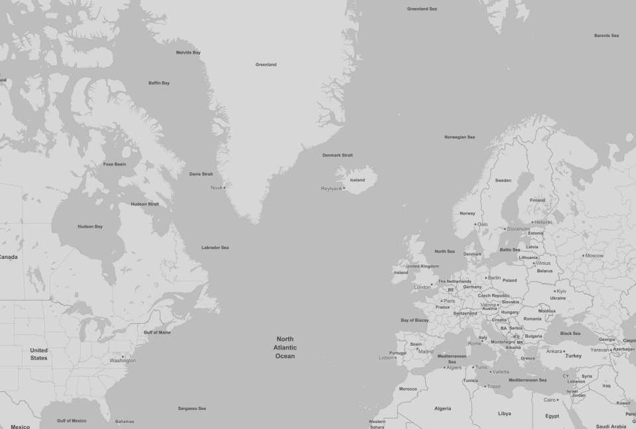


Deterring rapid Russian aggression
Location of Forward Basing or Stationing
Platform | 1 (stationed) 1 (based)
Ships | Operational Presence
Frigate | 1.1
XLDUSV | 2.6
XLDUUV | 2.6
Unmanned Vehicle Support Vessel | 0.8
Salvage / Fleet Tug | 1.0
P-8 detachment | 1.0
Ships | Operational Presence | Allies
CVN (CONUS) | 0.9
Destroyer | 4.3
Frigate | 3.3 | 1
XLDUSV | 5.1
SSN | 5.6
XLDUUV | 5.1
Large Multi-Product Logistics Ships (AOE) | 2.5
T-AKE | 1.0
T-AGOS | 1.0
Unmanned Vehicle Support Vessel | 2.0
Unmanned Vehicle Squadron | 2.0
MQ-4 detachment | 1.0
P-8 detachment | 2.0
Iceland
UUV / USV Det | 1
Norway
UUV / USV Det | 1
UK
DDG | 4
FFG | 4
SSN | 4
Germany
FFG | 2
Spain
DDG | 5
FFG | 2
Naval forces provide unilateral options to promptly deny Russian aggression in
Northern Europe – can mitigate delays by NATO

Slide 24
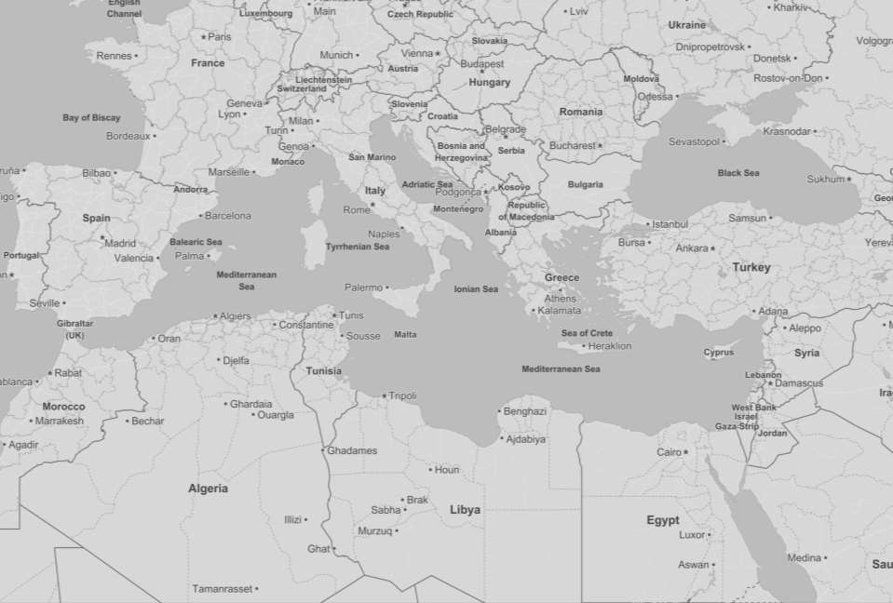


Engaging adversary forces globally
Location of Forward Basing or Stationing
Platform | 1 (stationed) 1 (based)
Romania
UUV / USV Det | 1
Italy
FFG
4
Spain
DDG | 5
FFG | 2
Greece
Patrol vessel | 10
Tender | 1
Turkey
UUV / USV Det | 1
Ships | Operational Presence | Allies
CVL (CONUS) | 1.3
Destroyer | 2.1
Frigate | 4.4 | 1
Patrol ship | 5.0
XLDUSV | 5.1
XLDUUV | 5.1
Small Deck Amphib (CONUS) | 2.6
Large Multi-Product Logistics Ships (AOE) | 3.0
Command Ship | 1.0
Unmanned Vehicle Support Vessel | 3.0
Unmanned Vehicle Squadron | 1.0
Tender | 1.0
Salvage / Fleet Tug | 1.0
MQ-4 detachment | 1.0
P-8 detachment | 2.0
Naval forces in Mediterranean support steady state ops and deter Russian or Chinese aggression by holding their fleets and expeditionary bases at risk

Slide 25
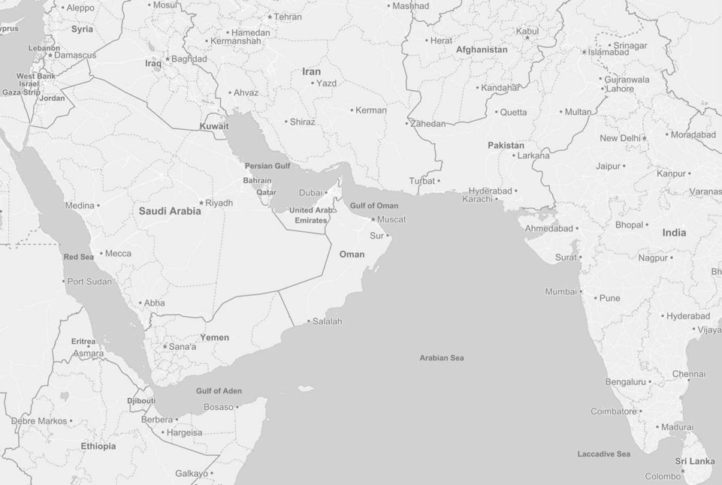


Countering threats proportionally
Location of Forward Basing or Stationing
Platform | 1 (stationed) 1 (based)
Ships | Operational Presence | Allies
East Africa/GOO/West Indian Ocean
CVL | 1.2
Frigate | 2.3
SSN (CONUS) | 1.0
Small Deck Amphib (CONUS) | 2.4
Large Multi-Product Logistics Ships (AOE) | 1.7
West Africa
Small Deck Amphib (CONUS) | 1.3
Persian Gulf
Frigate | 1.7
Patrol ship | 7.0 | 2
XLDUSV | 2.6
XLDUUV | 2.6
Small Deck Amphib | 1.2
Large Multi-Product Logistics Ships (AOE) | 1.0
Unmanned Vehicle Support Vessel | 2.0
Afloat Forward Staging Base | 1.0
Tender | 1.0
Salvage / Fleet Tug | 1.0
Command Ship | 1.0
MQ-4 detachment | 1.0
P-8 detachment | 1.0
Bahrain
UUV / USV Det | 1
FFG | 3
Patrol vessels | 10
AFSB | 1
Unmanned Vehicle Support Vessel | 2
Djibouti
FFG | 4
MCM and SUW in Gulf with smaller ships and UxVs; larger ships, CVL, and
amphibs support counter-terrorism & strike, threaten PLAN and RFN

Slide 26
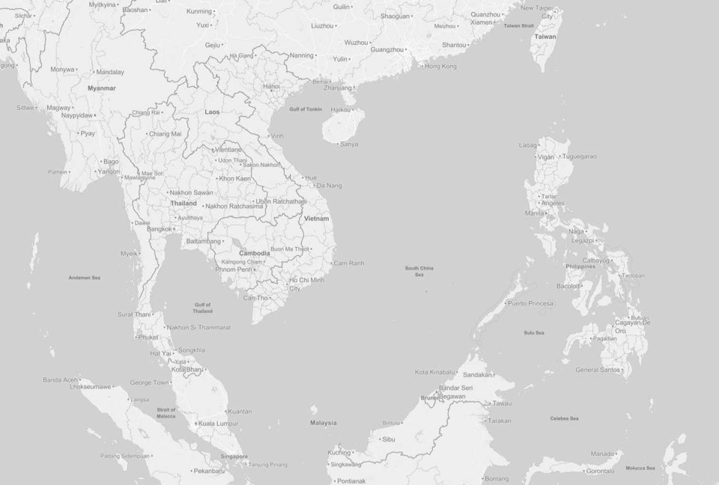





Regaining escalation dominance in SCS
Ships | Operational Presence
Destroyer | 2.6
Frigate | 3.4
Patrol ship | 5.0
XLDUSV | 5.1
SSN | 2.1
XLDUUV | 5.1
Small Deck Amphib | 1.5
Large Multi-Product Logistics Ships (AOE) | 3.0
T-AGOS | 2.0
Unmanned Vehicle Support Vessel | 2.0
Unmanned Vehicle Squadron | 1.0
Tender | 1.0
Afloat Forward Staging Base | 1.0
MQ-4 detachment | 1.0
P-8 detachment | 2.0
Philippines
UUV / USV Det | 1
Patrol vessels | 10
AFSB | 1
Tender | 1
Vietnam
UUV / USV Det | 1
Singapore
FFG
6
South China Sea force can proportionally counter PRC sub-conventional
aggression; has the lethality and staying power for high-end conflict

Slide 27
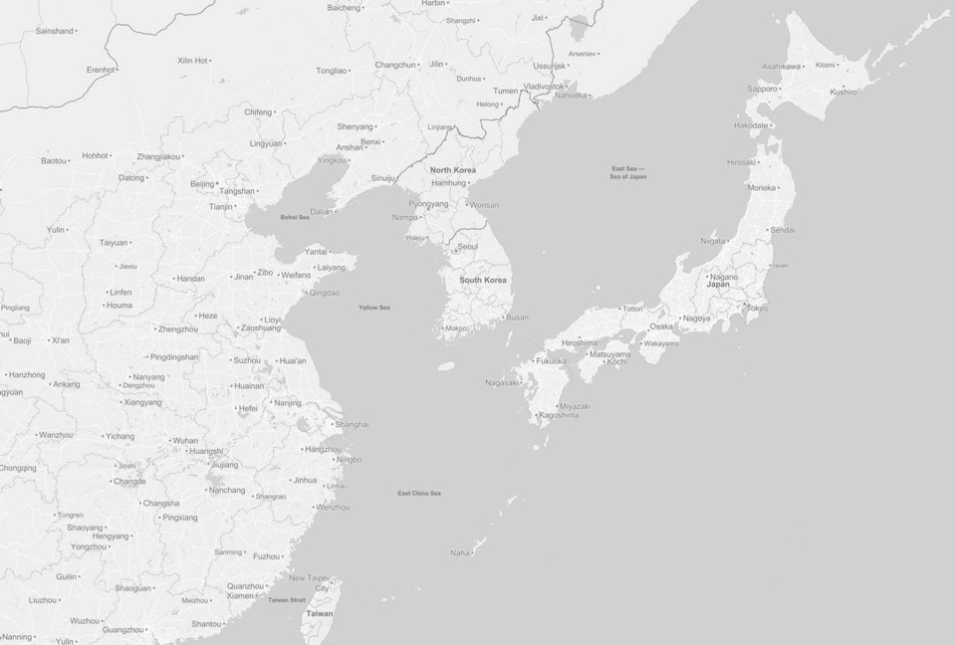




Complementing capabilities of allies
East China Sea
Ships | Operational Presence | Allies
DDG-1000 | 1.5
Destroyer | 4.5 | 1
Frigate | 5.4 | 2
XLDUSV | 2.6
SSN | 2.2
XLDUUV | 2.6
Small Deck Amphib | 1.5
Large Multi-Product Logistics Ship (AOE) | 4.2
Unmanned Vehicle Support Vessel | 2.0
Unmanned Vehicle Squadron | 1.0
Tender | 1.0
MQ-4 detachment | 1.0
P-8 detachment | 1.0
Japan
CVN | 1
CVL | 2
DDG | 13
Small Amphib | 6
FFG | 6
Tender | 1
Western Pacific
Ships | Operational Presence
CVL | 1.0
Destroyer | 3.0
XLDUSV | 2.6
SSN | 3.1
XLDUUV | 2.6
Large Multi-Product Logistics Ships (AOE) | 5.0
Unmanned Vehicle Support Vessel | 1.0
Large Multi-product ship hull w/VLS | 1.0
Tender | 1.0
Salvage / Fleet Tug | 2.0
Oceanographic Research Ship | 2.0
Command Ship | 1.0
MQ-4 detachment | 1.0
P-8 detachment | 2.0
Korea
DDG-1000
3
Guam
SSN
5
Tender
1
Providing SUW & strike capacity; counter-ISR, MIW, and ASW capability; and sustainment to complement JMSDF AMD and ISR capacity

Slide 28


Maneuver Force for sustained offense
Ships | Operational Presence | Allies
CVN | 2.0
Destroyer | 6.0
Frigate | 7.0 | 1
XLDUSV | 3.0
SSN | 4.0
XLDUUV | 3.0
Large Multi-Product Logistics Ships (AOE) | 4.0
Large Multi-Product Logistics Ship (AKE) | 2.0
Unmanned Vehicle Support Vessel | 2.0
MPS Squadron | 1.0
Not as effective in early stage of conflict due to size and vulnerability;
has time and “bandwidth” to prepare for high-end, sustained conflict

Slide 29

Implementing a new logistics concept
Ships | Minimum Wartime Requirement
Fast Combat Support Ships (T-AOE) | 38
Dry Cargo/Ammunition Ships (T-AKE) | 18
CONSOL Tanker (T-AOT) | 13
Geared Containerships (T-AK) | 5
Total | 74
Ports not used or likely unavailable for resupply; highly vulnerable
Ports in use
CONSOL T-AOT and T-AK Locations
T-AOEs/T-AKE support deterrence operations against opportunistic Russian aggression
Deterrence Force Operating Area
Maneuver Force Operating Area
T-AKE reload in rear-area ports or more distant CONSOL locations
T-AOE and T-AKE support Maneuver Force groups
T-AOE support Deterrence Force groups
T-AOEs refuel transiting surge forces
T-AOT and T-AK refuel and reload T-AOEs at CONSOL points
Using CONSOL tankers and geared containerships for at-sea resupply to reduce the need for T-AO and T-AKE shuttle ships to do long contested transits

Slide 30
Implications for naval aviation

Slide 31
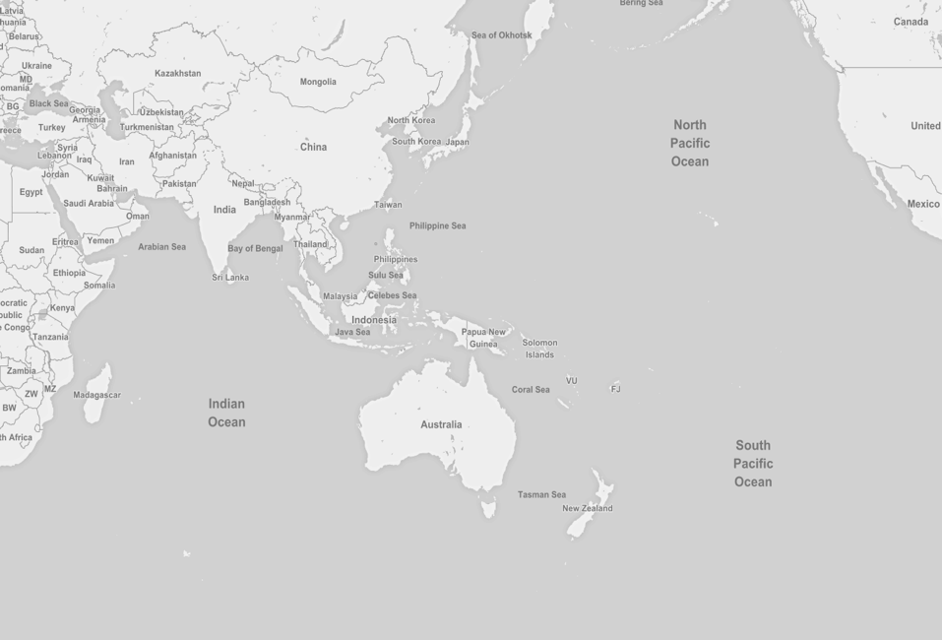
CVW must support Deterrence Forces
48 hours at 25 knots
UCAV Combat Radius
2000 nm
Wake Island
Hawaii
Position at the start of conflict
Guam
H+48
Position at the start of conflict
UCAV Combat Radius
2000 nm
Marshall Islands
2000 nm
H+48
Diego Garcia
3200 nm
1000 nm
Maneuver Force CVW will be first element to relieve Deterrence Forces as they retire after 1-2 days of combat–drives 2000 nm UCAV range

Slide 32






Maneuver Force combines 2 CVWs
Two V(U)AE squadrons:
Each with 6 x long-range, low-
observable unmanned strike aircraft
Two VF squadrons:
Each with 12 x low-observable fighters
Four V(F)A squadrons:
Each with 10 x F-35 multi-mission tactical aircraft
Two VAQ squadron:
Each with 6 E/A-18G Electronic Warfare aircraft
Two VAW squadrons:
Each with 5 E-2D AEW/C2 aircraft
Two VRC squadrons:
Each with 6 unmanned utility/tanker aircraft

Slide 33

CVL air wing focused on new concepts
Current ARG: 6x AV-8B, 12x MV-22, 3x UH-1, 4x AH-1, 4x CH-53
1x LHA
1x LPD
1x LSD
Four-Ship ARG Strike Optimized: 20x AV-8B/ F-35B, 4x MV-22, 3x UH-1, 4x AH-1, 4x CH-53
1x CVL
1x LPD
1x LXR
1x LXR
Four-Ship ARG Fast Assault Optimized: 10x AV-8B/ F-35B, 12x MV-22, 7x CH-53, 2 K-MAX
1x CVL
1x LPD
1x LXR
1x LXR
ARG air combat element shifts to support strike, SUW, and distributed amphibious operations

Slide 34
Training, maintenance, and readiness

Slide 35
Today’s readiness cycles must change
Amphibious ship and FDNF do not have sufficient time for maintenance;
O-FRP model does not efficiently use surface combatants

Slide 36
Deterrence Forces w/higher OPTEMPO
Deterrence Forces have a more limited set of geographic areas, threats, and potential operations than today’s FDNF; can employ high OPTEMPO cycle

Slide 37
Maneuver Force uses O-FRP cycle
Maneuver Force could operate over wide range of areas, against many different threats, and in multiple scenarios–needs more training and prep time

Slide 38
Force structure requirements

Slide 39
Proposed Fleet Architecture
 | Total Fleet Required | Additional Wartime Capacity Needed
CVN | 12
CVL | 10
Very Large Surface Combatant (DDG-1000) | 3
Destroyer | 71
Frigate | 71
Patrol vessel | 42
SSN | 66
SSBN | 12
Small Deck Amphib | 29
Oiler (T-AOE) | 26 | 12
Dry Stores Ship (T-AKE) | 4 | 14
Unmanned Vehicle Support Vessel | 14
Unmanned Vehicle Squadron | 6
Afloat Forward Staging Base | 2
Large Dry Stores Transport Ship w/VLS | 1
Tender | 5
Salvage / Fleet Tug | 6
Oceanographic Research Ship | 5
Command Ship | 3
Total ships (using today's rules) | 340
Total ships (adding patrol vessel) | 382
MQ-4 detachment (3 A/C) | 14
P-8 detachment (3 A/C) | 44
XLDUSV | 40
XLDUUV | 40
6

Slide 40
CSBA architecture larger, more diverse

Slide 41
Required fleet achieved in 2030s

Slide 42
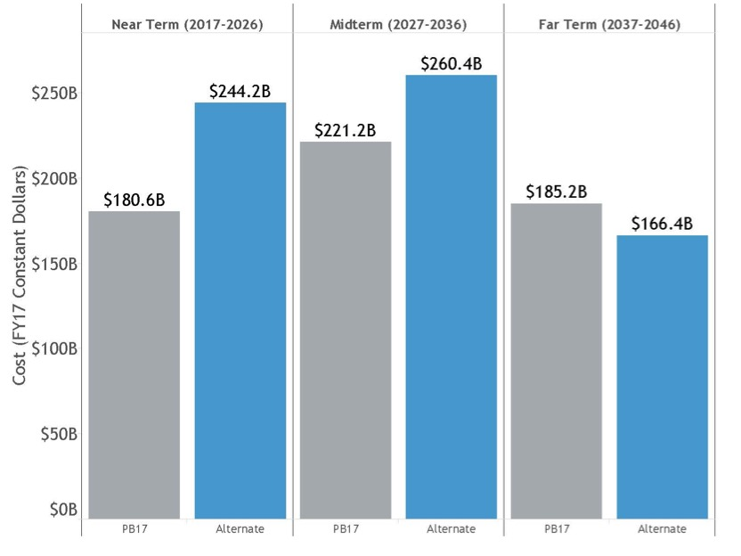
Architecture costs 16% more to build

Slide 43
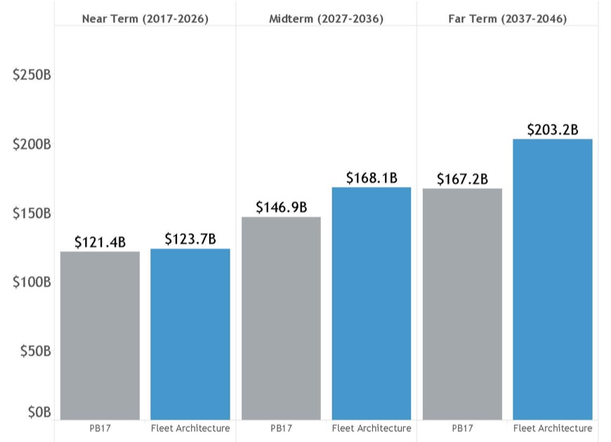
Architecture costs 15% more to own

Slide 44
Questions to address going forward
How will challenges from Russia and China develop?
  Could identify areas to accept risk by reducing size and cost of fleet
How can the U.S. fleet work better with allies and partners?
  Identify new contributions, synergies, and new opportunities
How will logistics requirements change for future operations?
  Addressing likely new operating concepts and postures
To what degree can unmanned replace manned platforms?
  Autonomy constrained by sensors; deterrent effect limited by self-defense
Can new sensors and weapons significantly change the fleet?
  Long-range, LPD systems enable fewer, highly distributed platforms

Slide 45
Designed for great power competition
– Posture to deny objectives and punish aggression in contested areas
More time and focus for learning and adaptation
  Deterrence Forces focused on their regions
  Maneuver Forces with time for experimentation and exercises
Improved integration with allies and partners
  Focused Deterrence Forces build stronger relationships and interoperability
Increased options for platforms, payloads, and sensors
  New force packages increase ways naval forces can attack and defend
Achievable fiscally and with industrial base
  Some additional cost, but risk can be taken in more expensive platforms
Exploits manned-unmanned teaming
  New operating concepts built to leverage UxVs and unmanned sensors
  Assumes realistic levels of autonomy and endurance

