Slide 1

Winning the Salvo Competition
Rebalancing America’s
Air and Missile Defenses
Mark Gunzinger and Bryan Clark
May 2016

Slide 2
Overview
Emerging salvo competition
  First report: Precision strike
  This report: Air and missile defense
Operational concepts to counter PGM salvos
Enabling capabilities and technologies
Barriers to change
Summary of recommendations
Notes:
First let me define what we mean by “salvo competition”
We use the term to describe the dynamic between two adversaries that have the ability to strike as well defend against its opponent’s strikes with precision
In other words, it has both an offensive and a defensive dimension
As we brief results of our study on the defensive dimension of this competition, we respectfully suggest that you keep in mind 3 key points:
First, our military is accustomed to assuming that its opponents would either be unable to strike U.S. theater bases and forces with precision, or would lack the capacity to overwhelm limited U.S. defenses. It is our contention that these assumptions are no longer valid.
Second, simply buying more of today’s air and missile defense capabilities to defeat enemy PGM salvos would be very expensive and possibly a prescription for failure
Rather, our report recommends DoD adopt operational concepts and take advantage of mature and maturing technologies that will give it an advantage in future competitions
I will summarize operational concepts that have the potential to cut the size and density of an enemy’s strike salvos, ideally to the point that U.S. defenders will have overmatch
Bryan will then address new technologies and capabilities that promise to increase our military’s salvo defense capacity as well as create more favorable cost exchanges for the U.S.

Slide 3


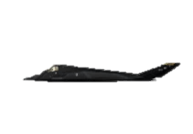



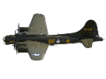

Precision guidance changed strike operations
Today
1 bomber sortie
80 PGMs (40,000 lbs)
Up to 80 targets
GPS and other guidance systems, larger stealth platforms
More targets per sortie
Laser guidance
Iraq, 2003
1 bomber sortie
16 PGMs (32,000 lbs) Up to 16 targets
1 to 1
Iraq, 1991
1 fighter sortie
2 laser-guided bombs (4,000 lbs)
1 or 2 targets
Targets per Sortie
Vietnam, 1970
30 fighter sorties
176 unguided bombs (88,000 lbs)
1 target
More sorties per target
Precision “replaced”
massed fires
Germany, 1944
1,000 bomber sorties
9,000 weapons (2,250,000 lbs)
1 target
Time
Notes:
I’ll begin with this graphic illustrating how the maturation of precision strike technologies, including sensors and precision guidance systems for individual munitions as well as strike platforms dramatically changed the number of weapons and sorties needed to attack target sets
In World War Two, Allied Air Forces resorted to using mass – by which I mean many sorties and bombs – to compensate for their lack of precision
Today, PGM accuracies are typically measured in single digit feet, giving our strike platforms the ability to kill multiple targets per sortie rather than requiring multiple sorties per target

Slide 4
Precision defenses eroding U.S. advantage
One or two PGMs per aimpoint no longer enough for targets protected by air and missile defenses
or other active and passive countermeasures
More targets per sortie
GPS and other guidance systems, larger stealth platforms
Smaller
air-delivered munitions
1 to 1
Laser guidance
Targets per Sortie
Iraq, 2003
1 bomber sortie
16 PGMs (32,000 lbs) Up to 16 targets
Iraq, 1991
1 fighter sortie
2 laser-guided bombs (4,000 lbs)
1 or 2 targets
Vietnam, 1970
30 fighter sorties
176 unguided bombs (88,000 lbs)
1 target
More sorties and PGMs needed per target
More sorties per target
Time
Precision guidance plus mass may be
needed in future strike campaigns
Notes:
As we described in our previous report, adversaries have gone to school on how the U.S. military has conducted its precision strike operations
Over the last twenty-five years, China, Russia, Iran, North Korea, and others have developed the means to degrade U.S. precision strike operations at every step of the find, fix, track, target, and attack “kill chain”
These countermeasures include precision defenses capable of intercepting individual PGMs such as cruise missiles as well as capabilities to directly attack U.S. launch platforms and their bases
As a result, instead of precision guidance reducing the need for “mass,” in future conflicts against enemies with effective countermeasures the U.S. military may need to rely on precision plus mass – mass in the form of many more strike sorties and PGMs

Slide 5
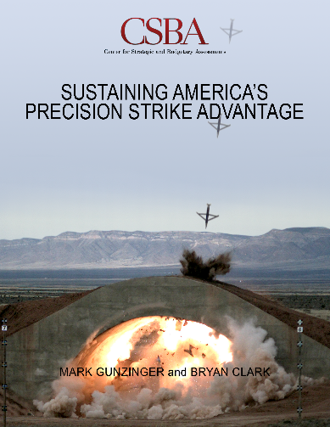
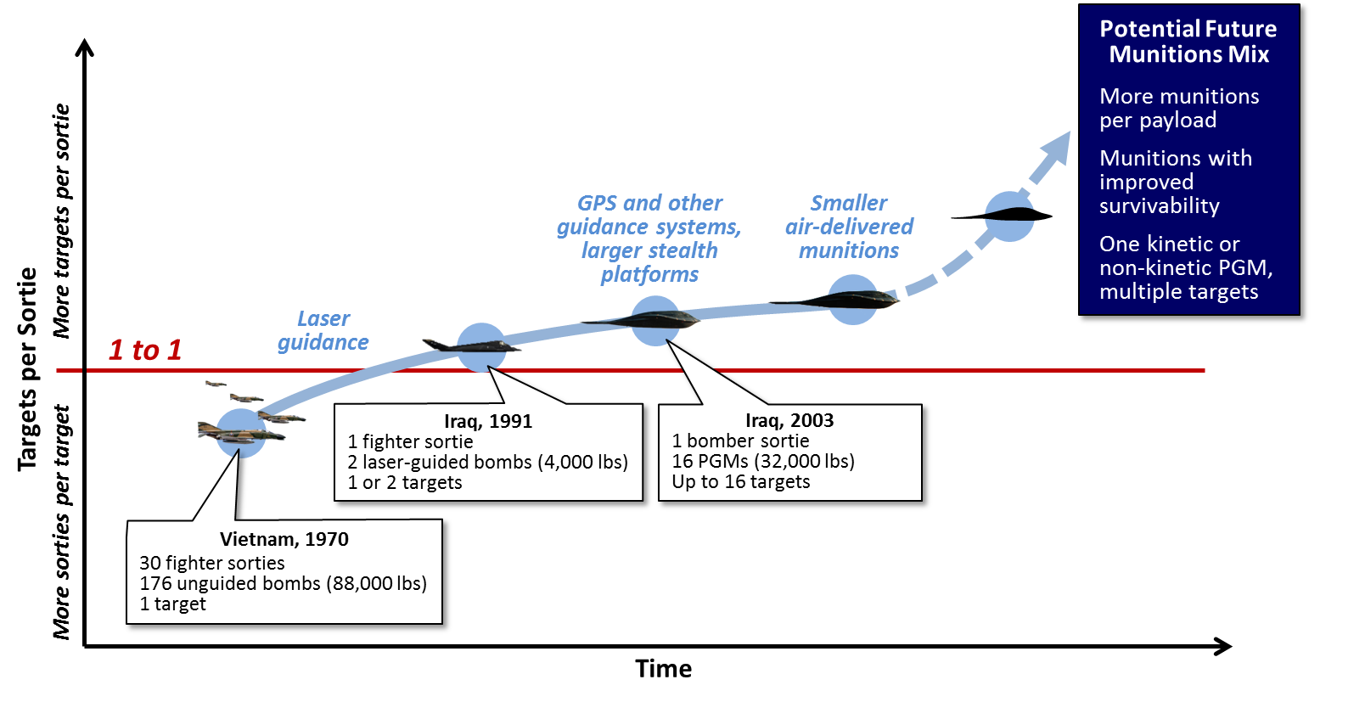
Strike report: Need to increase salvo sizes
Recommendations:
Maximize payloads using smaller PGMs
Engage multiple targets per weapon
Increase PGM survivability
Increase PGM lethality against challenging targets
Use multi-mission PGMs to increase platform capacity

Slide 6


























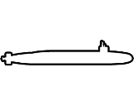
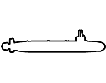
This report: Need to grow salvo defense capacity
Theater Ballistic Missile Salvo
Next Generation Survivable Long-Range Standoff Weapons
Kinetic Interceptors
Combat Air Patrols
Penetrating Aircraft with
Short-Range Standoff Weapons
High Velocity Projectiles
Cruise Missile Salvo
Combat Air Patrols
EW
High Energy Lasers
Dispersal Airfields
Undersea Penetration of A2/AD Umbrella
What was a U.S. strike and air defense advantage is
now a salvo competition – for offense and defense

Slide 7
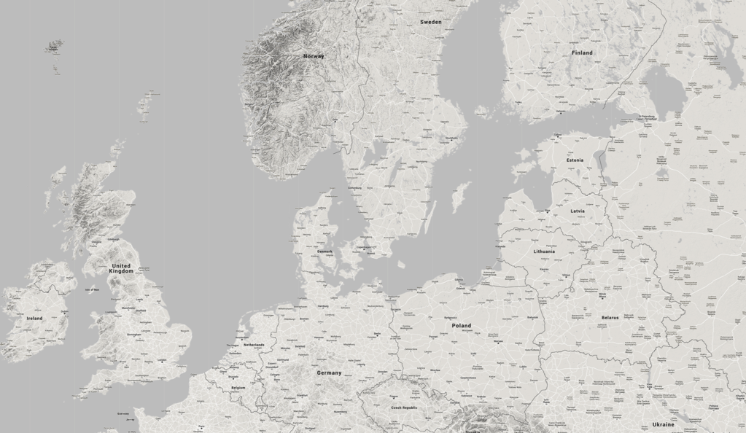
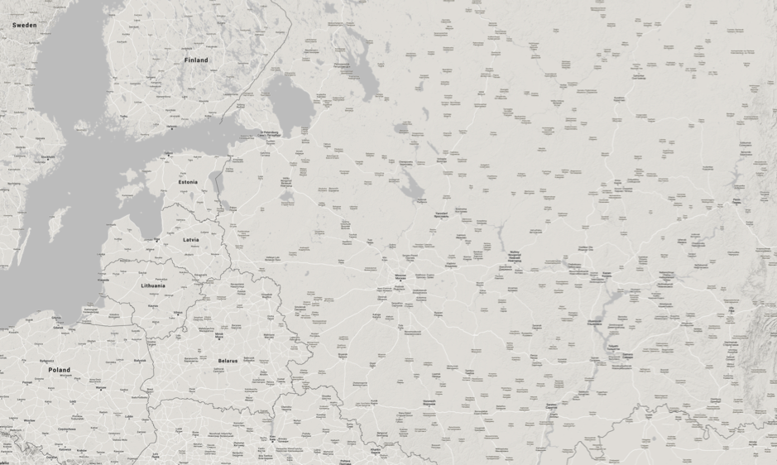
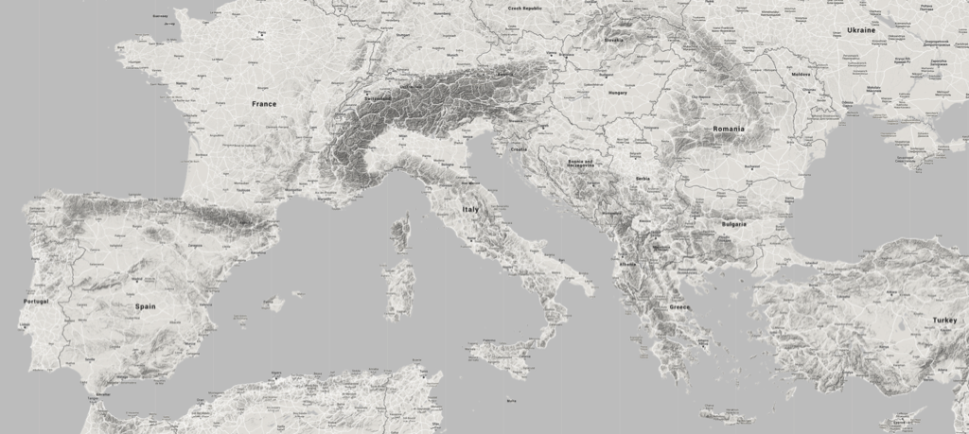
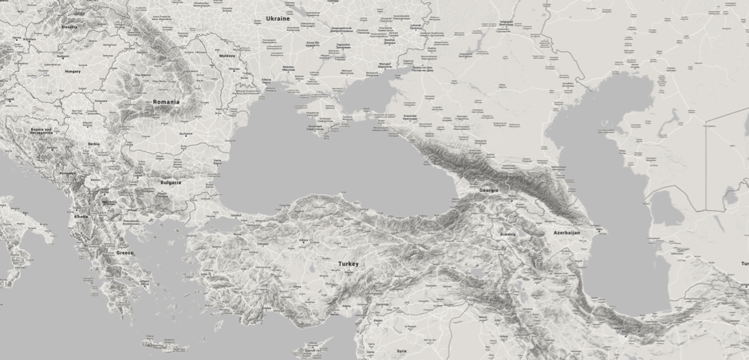
Threats increasing for U.S. air & missile defenses
Iskander-M SRBM
(500 km)
250 km
250 km
Western Military District
Su-35 Combat Radius
(1500-1600 km)
OTH-R Transmitter
Missile
Brigade Base
Central Military District
OTH-R Receiver
S-300PMU (90 km)
S-300PMU1 (150 km)
S-300PMU2 (200 km)
250 km
S-300VM (250 km)
250 km
S-300V4/S-400/S-500 (400 km)
29B6 Kontainer Over-the-Horizon Airspace Monitoring Radar
(3,000 km)
NOTE: Range arcs are illustrative of possible threats rather than an actual force laydown.
Southern Military District
Aegis Ashore
BMD Location
Russian, Chinese, Iranian, and North Korean guided
weapons are improving in accuracy, range, and payloads
250 km
250 km
7

Slide 8
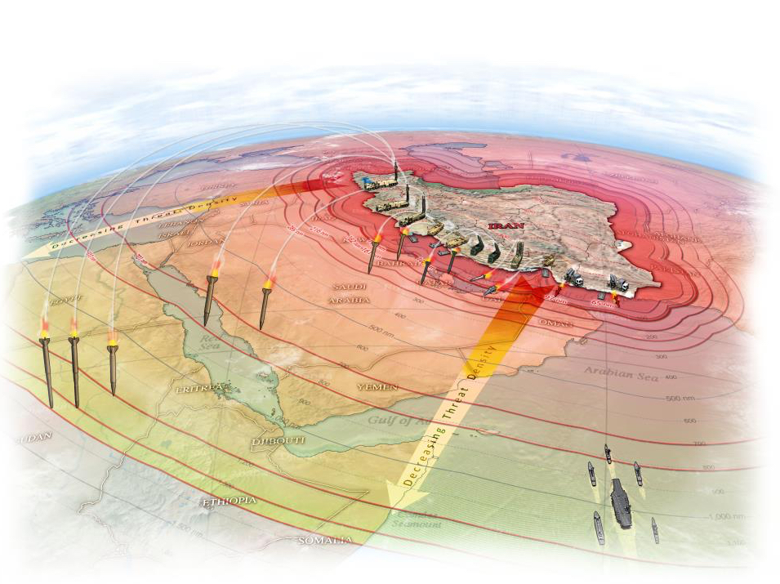
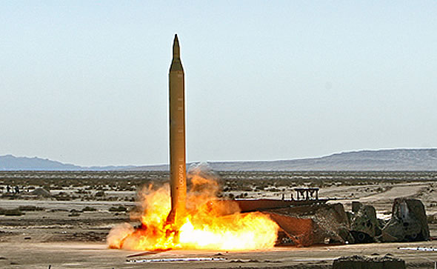
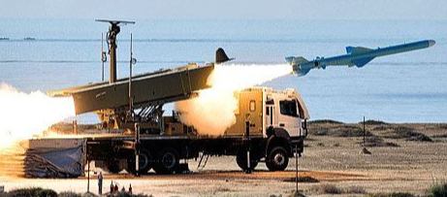
Iran fielding cruise & ballistic missiles
to coerce and attack at range
SRBM | Range (km)
Scud-B/ Hwasong-5 | 300
Tondar-69 | 150
Fateh-110 Fateh-110 2nd gen Fateh-110 3rd gen Fateh-110-D1 Khalij Fars ASBM Fateh-313 Hormuz-1 Hormuz-2 ASBM | 200 250 300 300 300 500 300 300
Shahab-1 Shahab-2 | 300 500
Qiam-1 | 800
Shahab
Ghader
MRBM | Range (km)
Shahab-3 Shahab-3A Shahab-3B Shahab-4 | 1,300-1,500 1,500-1,800 2,000-2,500 2,000
Ghadr-1 | 1,950
Sejil/Sejil-2/Ashoura Sejil-3 | 2,000 4,000
IRBM
Musudan (BM-25) | 4,000

Slide 9

China growing number & variety of weapons
Range:
400 nm
800 nm
1,200 nm
1,600 nm
2,000 nm
2,400 nm
2,800 nm
3,200 nm
H-6K
KD-20
(CJ-10)
JH-7
YJ-12
YJ-12
HQ-9
YJ-83K
YJ-63
J-11
(Flanker)
YJ-83K
S-400
(SA-21)
YJ-12
Chinese ICBMs
DF-4 (CSS-3) | 2,900+ nm
DF-5A (CSS-4 Mod 2) | 7,000+ nm
DF-31 (CSS-9 Mod 1) | 4,300+ nm
DF-31A (CSS-9 Mod 2) | 6,000+ nm
YJ-91
PL-12
Oahu:
3,785 nm
Mainland US:
(not incl. Alaska) 4,000+ nm
S-300 PMU1
(SA-20A)
S-300PMU2
(SA-20B)
Variation in Y-values is for illustration only, not intended to reflect relative altitude
DF-15A
(CSS-6 Mod 1)
In service / Full Operational Capability
In development / Initial Operational Capability
Pending foreign purchase
DF-11A
(CSS-7 Mod 1)
DF-15B
(CSS-6 Mod 2)
DF-16
DF-21D
(CSS-5 Mod 3)
DF-21C
(CSS-5 Mod 2)
DF-26
HN-2
HN-3
Y-62C
DH-10
(CJ-10)
Taipei
Fiery Cross Reef
(Spratleys)
Tengah RSAFB (Singapore)
Andersen AFB
(Guam)
NSF Diego Garcia
Scherger RAAFB
Senkaku
Islands
USFA Yokosuka
Tindal RAAFB
Learmonth RAAFB
Woody Island
(Paracels)
Subic Bay
Curtin RAAFB
Kadena AFB
(Okinawa)
Misawa AFB
Distances from notional targets to the nearest mainland PRC airbase (does not include Hainan or airfields in the South China Sea
USFA Sasebo
Relative air and missile threats to:
Aircraft
Surface Ships
Static Targets
9

Slide 10
Likely PLA tactic: first use
ballistic missiles to paralyze bases
500 km
750 km
1000 km
1500 km
2000 km
PLA Second Artillery Corps Conventional Missiles
Name | Range (km) | Payload (kg) | Missiles | Launchers
DF-11 | 350 | 800 | 1,000 to 1,200 | 200+
DF-11A | 400-600 | 500
DF-15 | 600 | ?
DF-15A | 900 | ?
DF-15B | 800 | ?
DF-16 | 800-1000 | ?
DF-21 | 1750 | 600 | ~100 | ~80
DF-21C | 1750 | 600
DH-10 | 1500-2000 | ~400 | 200-500 | 40-55
Total
Payload
Deliverable
Mix of SRBM force unknown
DF-11
SRBMs
600,000 kg
DF-11A
DF-15
DF-15B
DF-15A
MRBMs
60,000 kg
DF-16
DF-21
LACMs
125,000 kg
DH-10
Taipei
500 km
750 km
1000 km
1500 km
2000 km
Okinawa
Northern Tip of Luzon
Tokyo
(from rest of China)
Iwakuni
Tokyo (from Eastern Manchuria)
Manila
Central Mindanao
10

Slide 11
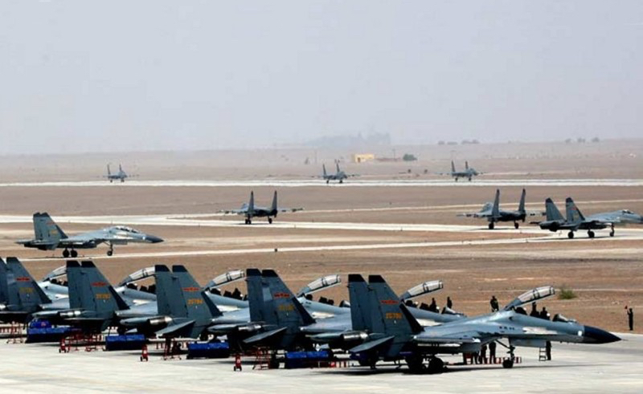
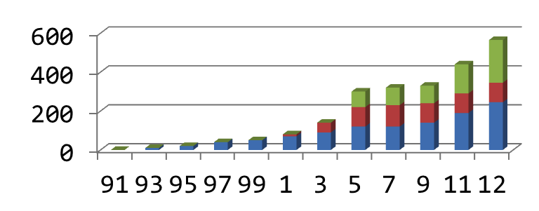
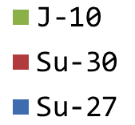
Weight of attacks come from PLAAF air strikes
Sustained strikes to attrite U.S. forces and suppress sortie rates
1 day of PLA Air Force strikes
240 x Su-27/Su-30/J-11 (50% of strike aircraft)
76 x JH-7 (75% strike aircraft)
(Figure assumes 4 hour aircraft turnaround time
between sorties and 70% availability rate)
2000 tons
1500 tons
The entire 2nd Artillery Corps can deliver only a fraction of the payload that the PLAAF can deliver in one day
1000 tons
PLAAF 4th Generation Fighters
DF-11
500 tons
DF-11A
DF-15
DF-15B
DF-15A
DF-16
DF-21
MRBMs
LACMs
DH-10
500 km
1000 km
1500 km
2000 km
Okinawa
Tokyo
11

Slide 12
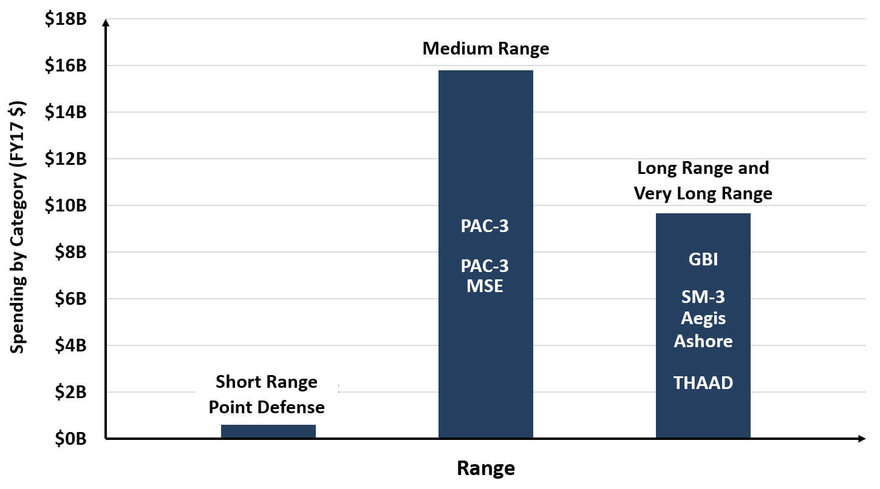
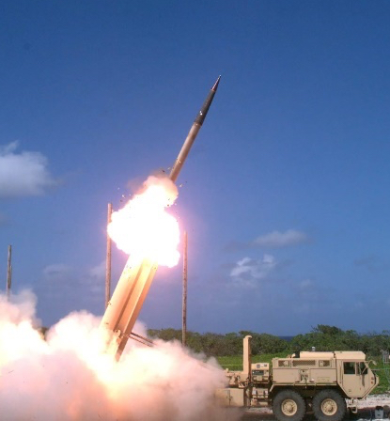
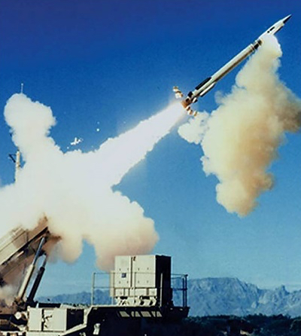
U.S. land-based defenses unbalanced
Best suited for defeating small number of rogue state ballistic missiles
  Small numbers of medium/long-range interceptors deployed to a few locations
  Little capacity to defend bases against salvos of cruise missiles and other PGMs
High unit cost of current interceptors impose costs—on us
Wake Island
THAAD launch,
Nov 2015
DoD cumulative land-based AMD interceptor procurement funding since 1999
PAC-3 MSE launch
12

Slide 13
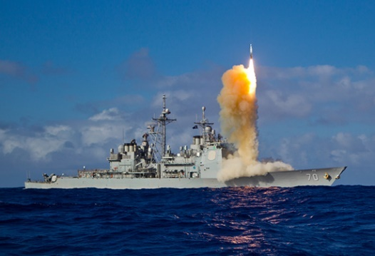
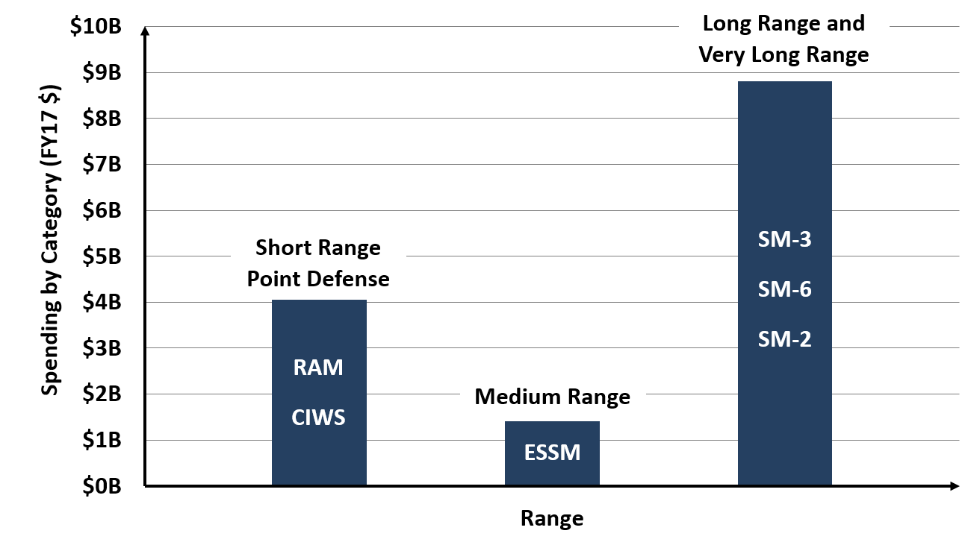
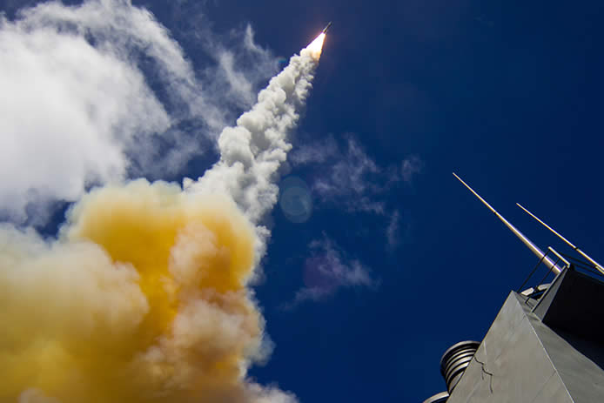
Navy’s “layered” defenses lack capacity
Kinetically intercept all air and missile threats as far as possible from ship
  Use shorter-range defenses (e.g., EW, CIWS, RAM) to pick off “leakers” as a last resort
  Drives requirements for long-range interceptors that are large and expensive
  Size of long-range interceptors reduces VLS capacity for offensive weapons
SM-6 launch from USS John Paul Jones,
Aug 2015
Navy interceptor procurement funding since 1999
SM-3 launch
13

Slide 14
Operational Concepts
Reduce density of enemy salvos; increase U.S. air and missile defense capacity
14

Slide 15
Operational concepts to thin PGM salvos and
increase density of air and missile defenses
Counter-C4ISR operations to:
  Degrade enemy’s ability to find, fix, track, and target effectively
Long-range air defenses:
  Prioritize attacks on enemy strike aircraft before they launch PGMs
Medium-range defenses:
  Preferentially use to counter large PGM salvos
Short-range defenses to:
  Protect individual high-value targets
Goal: Create conditions that would require an enemy
to launch salvos so large that they decide not to attack
15

Slide 16
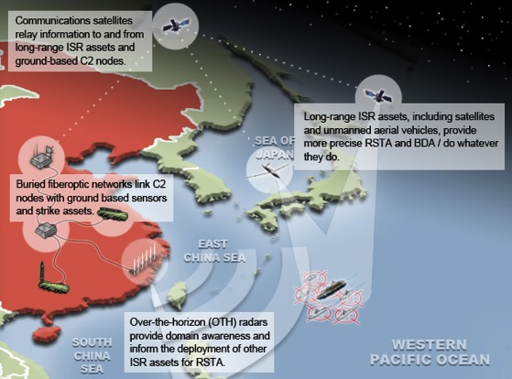
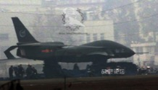
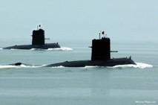
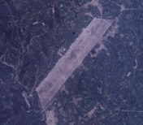
Degrade C4ISR networks that are the Achilles heel of A2/AD complexes
Strike capabilities need:
  Sensor networks to find, fix, and track targets
  Comm networks to provide them with targeting data
PLA long-range sensors include:
  Satellites
  Over-the-horizon radars
  Aircraft and UAVs
  Ships, submarines, possibly civilian vessels
Targeting data transmitted from sensors to shooters by:
  Communications satellites
  Airborne and terrestrial command centers
  Fiber-optic cables
  Radio networks
“Xianlong” high-endurance UAV
Song-class submarines
OTH radar receiver array, Hubei province
16

Slide 17
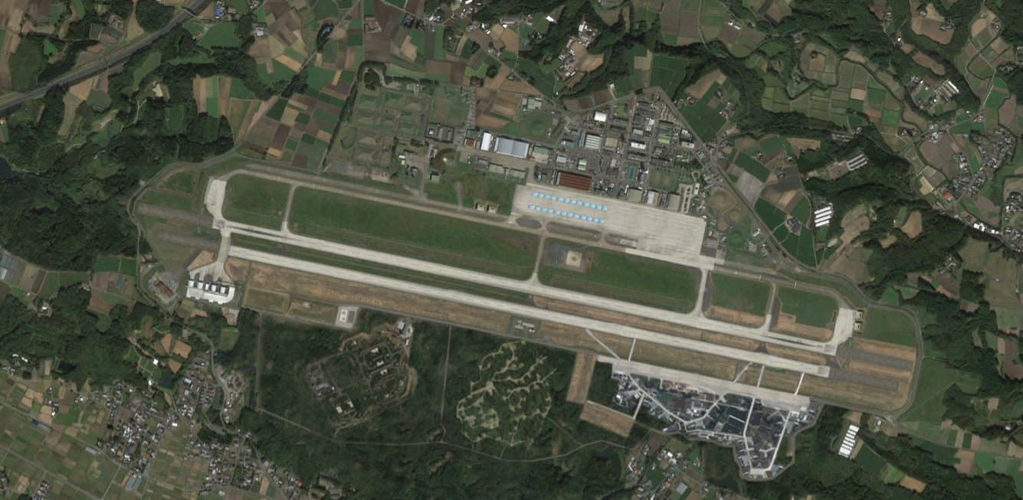
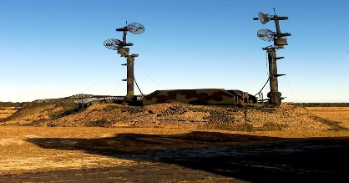
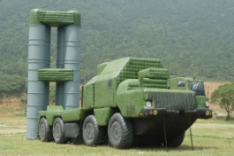
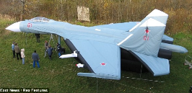
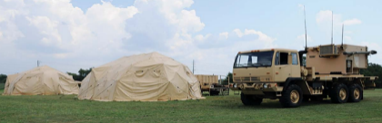
Degrade C4ISR with active and passive countermeasures and mobile systems
Multi-spectral camouflage (netting, decals, tenting)
Concealment, hardening (sheds, revetments, shelters, bury critical facilities
Sensor jamming (lasers against EO/IR sensors, EW against RF sensors)
Deception capabilities (inflatable decoys, RF/IR signature generators, etc.)
Yellow = Potential Measures
Weapons storage
area
EW systems and counter-EO/IR laser
Underground
fuel tank
Inflatable decoy SAMs
Submunition shelters
High energy laser revetments
Underground
fuel tanks
Movable decoys
Taxiway ready for
emergency takeoffs and recoveries
Hardened shelters
2nd hardened runway
High energy laser revetments
Dispersed weapons
storage area
EW systems and counter-EO/IR laser
SAM/HVP battery
revetments
Deeply buried and
reinforced fuel stores
Camouflage, netting
Hardened shelters and
contingency ramp space
Nyutabaru Japan Air Self-Defense Force Base

Slide 18













Attack enemy “archers” before they
launch their PGM “arrows”
Max range for KD-20 to reach Guam (~1,190 nm)
Japan
Max range for DF-26 to
reach Guam (~2,160 nm)
Survivable
ISR
Key
U.S. airbase
Allied airbase with fighter units
Possible U.S. dispersal sites
(7,000’+ runway)
PLA Air Force H-6 bomber bases
China
HALE ISR UAS detect inbound threats
H-6K strike
operations
Okinawa
Iwo Jima
Taiwan
Ships with long-range SAMs
U.S. counter-air
operations
Directed energy cruise
missile intercepts
Tinian & Saipan
Philippines
Guam
OTH radar network with multi-static transmitters/receivers in Second Island Chain
Palau
Defensive counterair operations supported by AWACS and surface combatants
Fighters with air-to-air missiles and laser pods intercept threats (F-15E radius = 685 nm)
Stealth ISR aircraft use variety of means to listen to or observe inbound aircraft
Broad area maritime surveillance to track air & missile penetrations,
Support Aegis BMD operations
THAAD BMD
(out to 160+ nm)
DF-26 maximum launch range
(2,160 nm)
Shortest distance to PRC mainland
(1,595 nm)
KD-20 max launch range
(1,190 nm)
Local defenses
2,200 nm
2,000 nm
1,800 nm
1,600 nm
1,400 nm
1,200 nm
1,000 nm
800 nm
600 nm
400 nm
200 nm
Guam

Slide 19
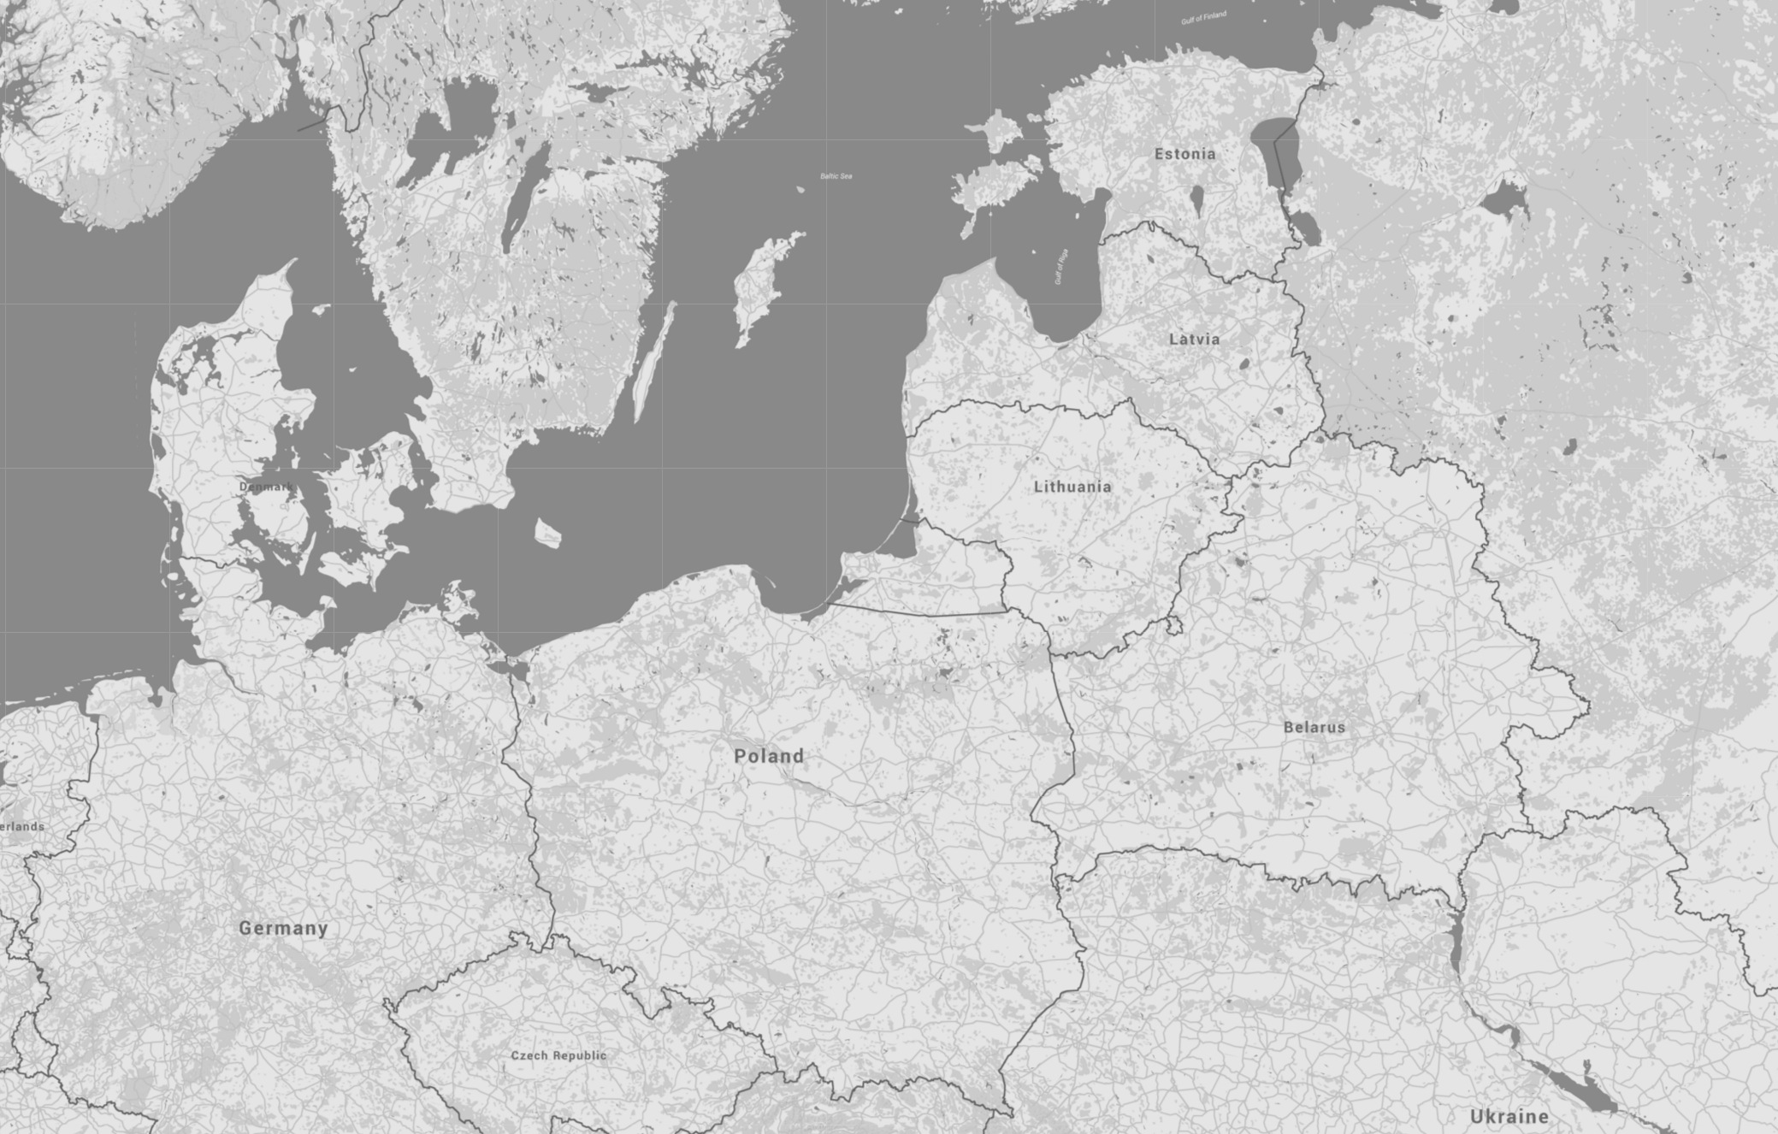




Disperse and frequently move
U.S. forces between operating locations
Civilian and abandoned airfields presented with C-17 operations in mind. All are paved. C-130s have additional options and can more easily operate from non-paved airfields. Non-STOVL fighters generally require 7,000 ft. of runway for safe operations.
Poland also has a number of highway strips suitable for fighter operations. Highways are generally too narrow for transport aircraft.
Dilute an enemy’s salvos, induce it to waste more weapons to hit same number of targets
Result: each U.S. operating location receives smaller number of weapons
Key
Potential facilities for Allied dispersed ops
Naval facility
Potential JHSV Site (300’+ ship length)
Military/dual-use airbase or heliport
Inactive/abandoned gov’t/military airfield
Civilian airfield (3,500’+ by 90’+, 140’+ turns)
Russian Iskander SSM brigade base
Dispersal
Dispersal
Dispersal
U.S. and Allied military aircraft disperse to existing airfields and alternative operating locations (e.g., prepared highways) during a crisis
Dispersal
Russian Iskander-M missile range from forward positions (270 nm)
250 nm
19

Slide 20





Local area dispersal, take advantage of overlapping defenses
Dispersing across base “clusters” would further dilute an enemy’s salvos
Clustering enables mutually supporting air and missile defense operations, increasing capacity at multiple locations
Mutually supporting logistics operations another benefit
9,100’
THAAD Engagement (~165+ nm)
6,450’
Nearest mainland airbase
(585 nm)
PAC-2 SAM Engagement (~85 nm)
6,900’
4,250’
ESSM Engagement (~30 nm)
PAC-3 MSE Engagement (~20 nm)
Fort Magsaysay, 5,250’
Clark Airbase, 10,500’, 10,500’
Basa Airbase, 8,400’
Subic Bay, 9,000’
Ninoy Aquino Int’l, 12,250’, 7,400’
Woody Island
(520 nm)
Sangley Point Airbase, 7,750’
Fernando Airbase, 4,950’
100 nm
4,100’
Fiery Cross Reef
(560 nm)
5,100’
4,600’
4,750’
20
4,250’
7,450’

Slide 21




Shift toward medium-range air and missile defense operations
Adopt operational concepts and field capabilities to create denser, higher-capacity air and missile defenses
  Offensive anti-air warfare: Use long-range surface-to-air missiles to intercept strike aircraft before they can launch their weapons (kill the archers)
  Defensive anti-air warfare: Preferentially use medium-range (10-30 nm) kinetic and non-kinetic systems such as ESSM, RAMs, guided HVPs and other projectiles, EW, solid-state lasers, and high power microwave weapons (kill the arrows)
ASBMs
HVPs
30 to 40 nm
defensive anti-air warfare
5-10 nm
ship self-defense systems
ASCM salvo
RAM
EW, HPM
Lasers
ESSM
LCS
DDG
JHSV
CIWS
LCS

Slide 22





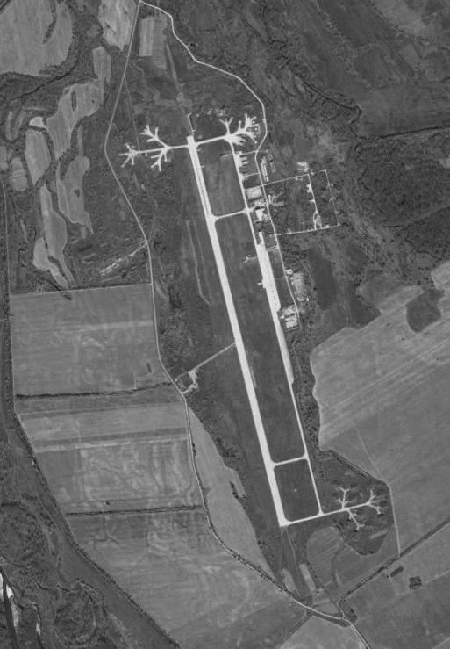








Illustrative medium-range and point defenses for theater bases
Unmanned jamming aircraft disrupt enemy communications and ELINT efforts
Jammers prevent enemy SAR satellites from locating targets
Surface-to-air interceptor launchers with deep magazines of short-range weapons
Lasers blind enemy space-based EO/IR sensors
Enemy strike aircraft
Mobile HPM and tactical EW systems disrupt enemy PGMs
UAV decoys simulating fighters deceive enemy on location and tempo of U.S. operations
Elevated mobile lasers thin
cruise missile salvos
Combat air patrol fighters intercept enemy strike aircraft
Enemy strike aircraft

Slide 23
Enabling Capabilities and Technologies
23

Slide 24
Systems of systems approach needed
New kinetic defenses
  Medium-range interceptors: smaller than long-range weapons
  Artillery with guided projectiles: inexpensive and numerous
New non-kinetic defenses
  Directed energy: high energy lasers and high power RF weapons
  Electronic warfare: jammers, decoys, deception
Battle management systems
  Match defensive system against incoming enemy weapons
  Coordinate fires at high speed to engage large salvos in 30 nm
No single system will provide lethality and high capacity;
different threats have different vulnerabilities
24

Slide 25
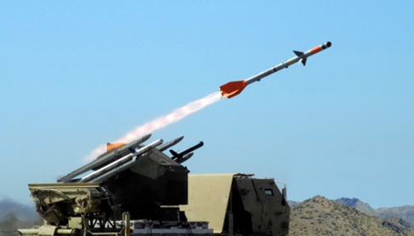
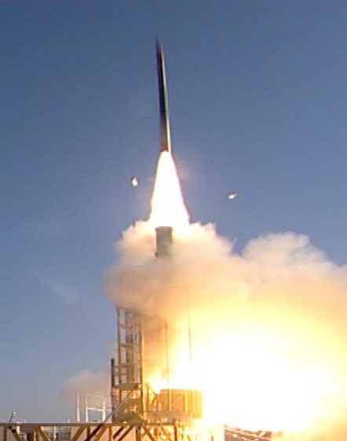
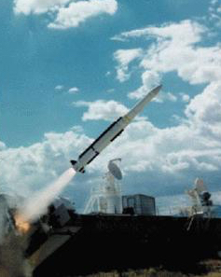
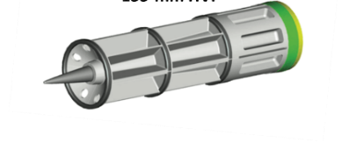
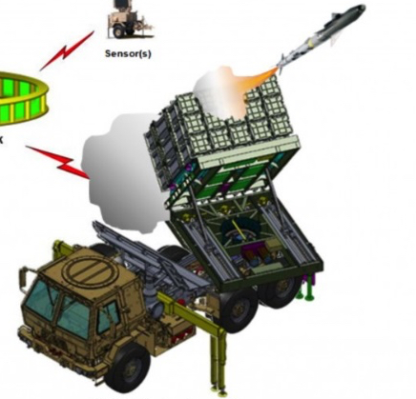
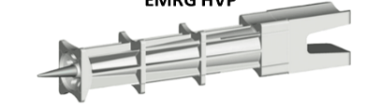
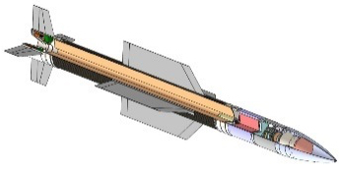
New medium-range kinetic defenses
155-mm HVP
AI3 Interceptor
ESSM
IFPC Incr 2-1 and Multi-Mission Launcher
EMRG HVP
Lower AD Interceptor
David’s Sling
Capability | Firing Rate Per Minute | Approx. Max Range | Guidance | Unit Cost (FY16 $)
Powder gun with Hypervelocity Projectiles | 6-20 | 10-20 nm | INS, command guidance | $25-$100k (HVP only)
Electromagnetic railgun with hypervelocity Projectiles | 6-10 | 10-40 nm (depending on power) | INS, command guidance | $25-50k (HVP only)
Medium-caliber rapid-fire gun with guided projectile | 80 | 5-10 nm | Active radar | $125k (5-round burst)
Accelerated Improved Interceptor Initiative (AI3) | 30-60 | 5-7 nm | Active radar | $100k
IFPC Increment 2-1 w/ MHTK or AIM-9X interceptor | 15 | 7-15 nm | Datalink, imaging IR | $420k
Low-cost Extended Range Air Defense (Lower AD) | 30-60 | 15-20 nm | Active radar and passive IR | $400k
Evolved Sea-Sparrow Missile (ESSM) Block 2 | 30-60 | 30 nm | Active radar and passive IR | $1,481k (VLS variant)
25

Slide 26
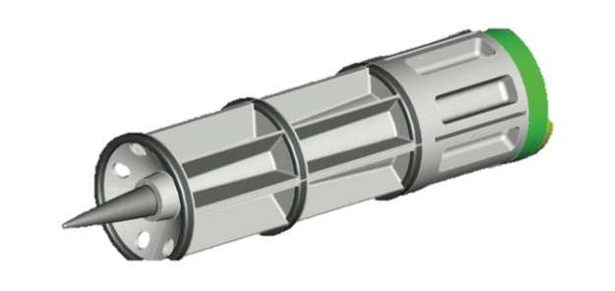
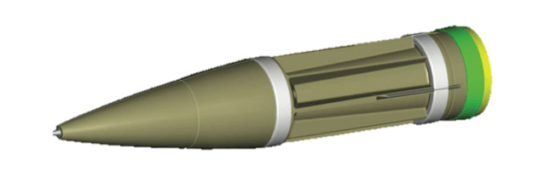
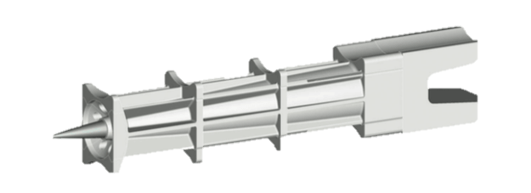
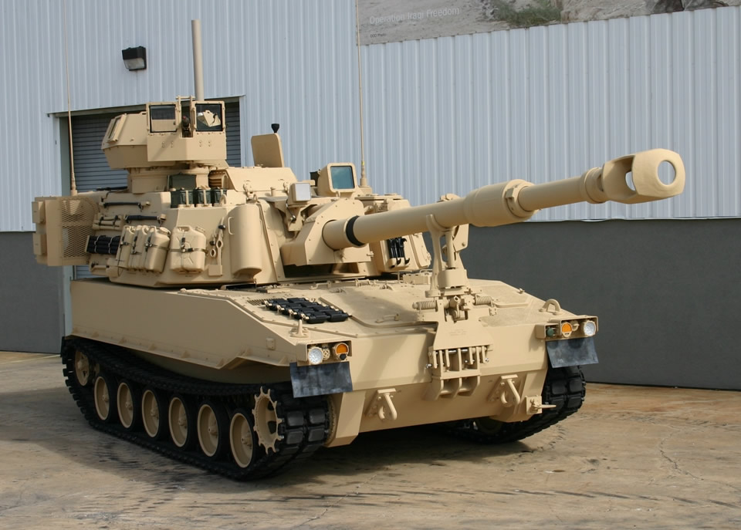
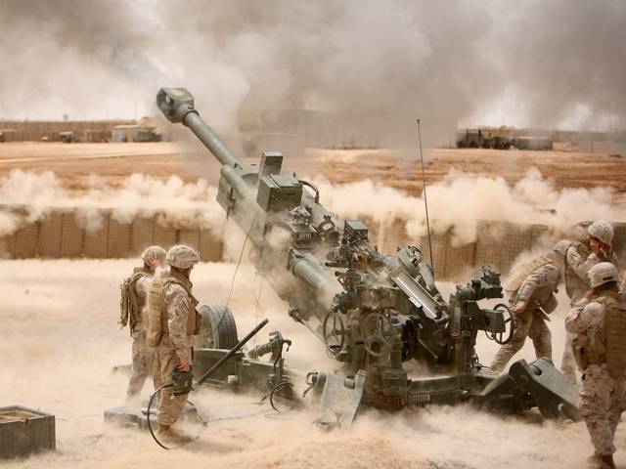
Artillery with hypervelocity projectiles
155-mm HVP
Example: HVP from 155mm gun
Effective intercept range:
  20 nm against airborne targets
  10 nm against low-flying targets
Paladin max firing rate: 6 rounds per minute
5” Gun HVP
EMRG HVP
“Powder” guns can be a low-cost defense against missiles
and G-RAMM, but will have limited ranges and firing rates
26

Slide 27



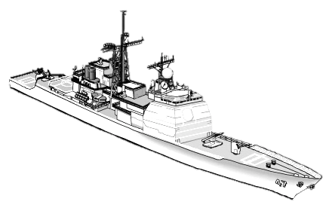



Rapid-fire medium caliber guns
MAD-FIRES projectiles compensate for threat maneuvers
Kill assessment
Incoming armed UAVs and maneuvering, sea-skimming ASCM threats
6
5
1
2
Threats detected by radar at horizon break
Tracks created, fire control system calculates threat trajectories
4
1
MAD-FIRES projectiles fired at Predicted Impact Point (PIP)
3
The ability to intercept maneuvering threats will be a key requirement for guided projectile defenses
27

Slide 28







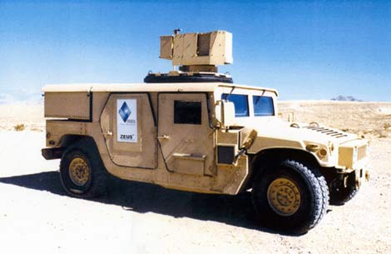
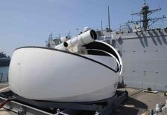
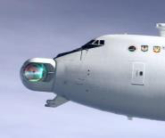
Future directed energy defenses
High power microwave weapons
  Lowest incident power (or longest range) against PGM antennae/seekers
  Highest powers needed (or short range) against PGM internal components
Solid-state lasers (SSLs)
  <100 kW to defeat EO/IR sensors
  ~100-300 kW to defeat UAVs
  300-600 kW to defeat cruise missiles
Complement kinetic systems
Very low cost per engagement (less than $10), but…
Can be affected by weather and airborne particulates
Most effective over relatively short ranges (especially ground-based lasers)
Detonate explosives
Destroy soft UAVs at short ranges
Destroy aircraft and cruise missiles at short ranges
Destroy soft UAVs at longer ranges
Destroy aircraft and cruise missiles at longer ranges
Defeat short-range, non-RV theater ballistic missiles
Counter ballistic missiles in
boost phase
10 kW
100 kW
1 MW +
Future SSLs
Future SSLs
Zeus HLONS
LaWS (SSL)
Airborne Laser (COIL)
28

Slide 29
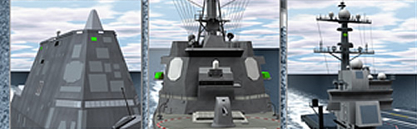


Active counter-targeting systems
Theater EW systems deny enemy ability to find targets
  Reduce enemy’s search rate
  Increase # of possible targets
  Requires more weapon seekers
Tactical EW systems defeat weapons at med. range
  More weapons with seekers
Ground-based, high-energy lasers vs/ EO/IR sensors
  On ISR systems and weapons
Obscurants such as chaff and smoke
29

Slide 30


















Battle Management systems essential
EO/IR
Red SATCOM uplink jamming
SATCOM
To theater C3
X
X
Target
data collected
Airborne RF/lasercom layer
Targeting data passed to
long-range shooters
Stealthy UAS w/
EO/IR or SIGINT
Ad hoc
network formation
Comms Relay UAS
Stealthy Bombers
Counter-Space Laser
Cooperative Engagement Capability (CEC)
Over-the-Horizon Radar
Land-based VLS
C4ISR Facilities
IADS
UCAV or Fighters
Red buried fiber comms
Combat Air Patrols
Surface Combatants
IRBM Launchers
EW
Coastal ASCMs
RF-Acoustic Gateway
30
UUV
SSN
SSGN
Aegis Combat System and Integrated Air and Missile Defense Command System can manage fires; improving flexibility
30

Slide 31
Illustrative Case Studies
31

Slide 32
Medium-range defenses
make ships unattractive targets
Current
Proposed Alternative
400
Number of Defensive Engagements
Weapon | CG and DDG-51 | DDG-1000
SM-3 | 10% VLS | 0% VLS
SM-6 | 20% VLS | 20% VLS
SM-2 | 30% VLS | 30% VLS
ESSM | 10% VLS | 10% VLS
Tomahawk | 25% VLS | 40% VLS
VLA | 5% VLS | 0% VLS
Weapon | CG and DDG-51 | DDG-1000
SM-3 | 10% VLS | 0% VLS
SM-6 | 20% VLS | 20% VLS
SM-2 | 15% VLS | 30% VLS
ESSM | 25% VLS | 10% VLS
Tomahawk | 25% VLS | 40% VLS
VLA | 5% VLS | 0% VLS
1 Mk-45 gun with HVP | 20 rounds per minute
1 400kW laser | 6 seconds per missile defeat
SEWIP Block 3 | 36 simultaneous targets
1 HPM system | 36 simultaneous targets
May be infeasible & costly for enemy to launch 100s of weapons
32

Slide 33
CSGs able to overcome structured attacks
Current
Proposed Alternative
Number of Defensive Engagements
Range from Defensive System to Threat
Range from Defensive System to Threat
1 Carrier and 4 DDG-51, each with the following
SM-3 | 10% VLS
SM-6 | 20% VLS
SM-2 | 30% VLS
ESSM | 10% VLS
Tomahawk | 25% VLS
VLA | 5% VLS
1 Carrier and 4 DDG-51, each with the following
SM-3 | 10% VLS
SM-6 | 20% VLS
SM-2 | 15% VLS
ESSM | 25% VLS
Tomahawk | 25% VLS
VLA | 5% VLS
1 Mk-45 gun/ship with HVP | 20 rounds per minute
1 400kW laser/ship | 6 seconds per missile defeat
SEWIP Block 3 | 36 simultaneous targets
1 HPM broadband system/ship | 36 simultaneous targets
More than half capacity is repeatable for multiple salvos
33

Slide 34
Proposed CSG mix - less long-range capacity
Focus systems on defeating aircraft & most challenging weapons

Slide 35
Portfolio at medium range grows capacity
Assume:
Interceptor Pk = 0.7
Other Pk = 0.4
211 kills
123 kills
Even w/ some low Pk systems, CSGs able to defeat 100s of weapons

Slide 36
Dramatic increases possible in base defense
Defensive System | Current | Proposed
Patriot battalion | 4 PAC-2 and 2 PAC-3 launchers | 2 PAC-2 and 4 PAC-3 launchers
THAAD battery | 6 launchers | 6 launchers
DCA CAP | 4 fighters each with 4 AIM-120C | 4 fighters each with 4 AIM-120C
IFPC Increment 2-1 |  | 3 IFPC launchers each with 15 AIM-9X Block II
400 kW Laser |  | 6 lasers, assume 6 seconds per missile defeat
Paladin gun w/HVP |  | 6 guns, assume 8 rounds per minute each
SEWIP Block 3 |  | 1 SEWIP, assume 36 simultaneous targets
HPM broadband system |  | HPM, assume 36 simultaneous targets
36

Slide 37
New mix provides about same LR capacity
Shift focus when possible from TBMs to enemy aircraft

Slide 38
Land-based defenses grow capacity, dispersal
Assume:
Interceptor Pk = 0.7
Other Pk = 0.4
71 kills
16 kills
New defenses can prevent enemy’s desired level of overmatch

Slide 39
Creating cost advantages:
CSG defense cost comparison
Cost to defeat each ASBM in a salvo
Cost assuming 60% PES
Using long-range interceptors
Using medium-range interceptors
$36 m
60% PES
$1.5 m
Cost to defeat each ASCM in a salvo
Cost assuming 60% PES
Using long-range interceptors
Using medium-range interceptors
$7.0 m
60% PES
$1.5 m
39

Slide 40
Creating cost advantages:
Base defense cost comparison
Cost to defeat each ballistic missile in a salvo
Cost assuming 60% PES
Using long-range interceptors
Using medium-range interceptors
$5.2 m
60% PES
$4.7 m
Cost to defeat each LACM in a salvo
Cost assuming 60% PES
Using long-range interceptors
Using medium-range interceptors
$35 m
60% PES
$10 m
40

Slide 41
Barriers to Change
41

Slide 42
Annual DoD procurement funding
for interceptors since 1999
Recent trend has been flat/downward, despite the growing threat
Also reflects a continuing bias for long-range air and missile defenses
Annual Interceptor Procurement (FY17 $)
Short Range
Point Defense
Medium
Range
Long Range and
Very Long Range
Total
42

Slide 43

Comparing procurement funding for interceptors with S&T funding for “electric” weapons
Reflects bias for kinetic air and missile defense solutions
No acquisition programs yet established for SSLs, HPM defenses, railguns
2012 report: lack of funding may now be the more significant barrier to fielding DE weapons than technology maturity … still true today
43

Slide 44
Contributing factor: unclear responsibilities within DoD
Missile Defense Agency has the authority to develop a Ballistic Missile Defense System, but is not responsible for cruise missile defense
Joint Integrated Air and Missile Defense Organization lacks authority to establish requirements and create acquisition programs
(primarily MDA)
(primarily MDA)
Continuing issue between the Army and Air Force: who should pay for airbase defenses?
  Example: IFPC Incr. 2-1 could defend bases against cruise missiles, but currently will defend maneuver units only
Breakout of 1999-2017 total interceptor
procurement funding by organization
Short Range
Point Defense
Medium
Range
Long Range and
Very Long Range
44

Slide 45
Summary
45

Slide 46
Summary of recommendations
Shift toward operational concepts that will reduce enemy salvos and increase the capacity and density of U.S. air and missile defenses
  Dispersal, cluster basing, increasing base resiliency, preferential use of medium-range defenses
Invest in medium-range kinetic interceptors
  HVPs, other gun-launched, low-cost guided projectiles with high firing rates
Develop and field non-kinetic defenses, including EW, SSLs, HPM
  Increase defense capacity and help create favorable cost exchanges
Create systems of systems for integrated and missile defense that degrades enemy precision strike kill chains
  Including capabilities to prevail in network – counter-network competitions
Congress and DoD clarify responsibilities for air and missile defense
  Especially for defending theater bases against cruise missiles and other PGMs
46

Slide 47
Questions?
47

